Slide 1
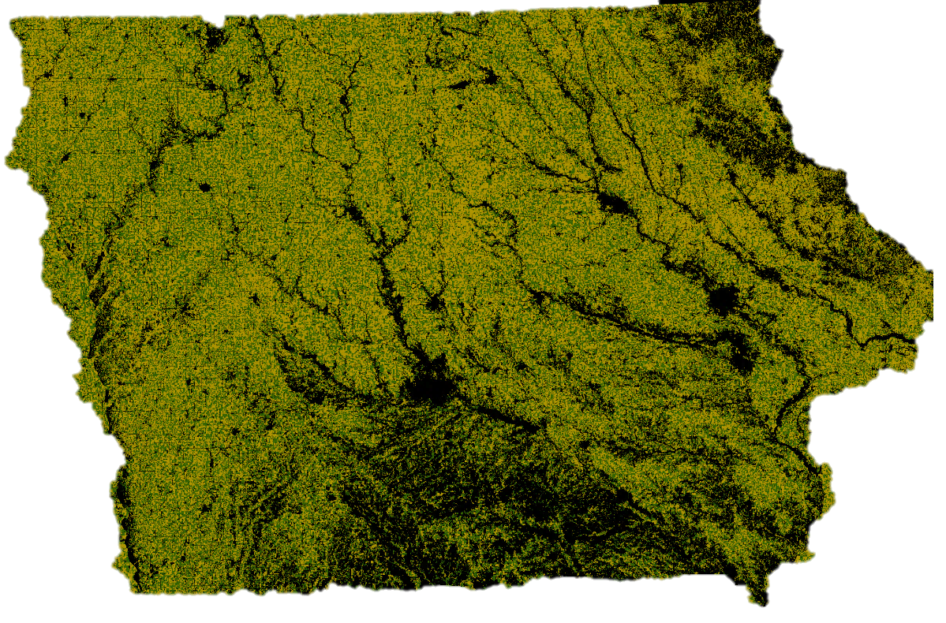
Anything but simple.
Gina Nichols | PhD Defense | Crop Physiology | August 25 2021

Slide 2
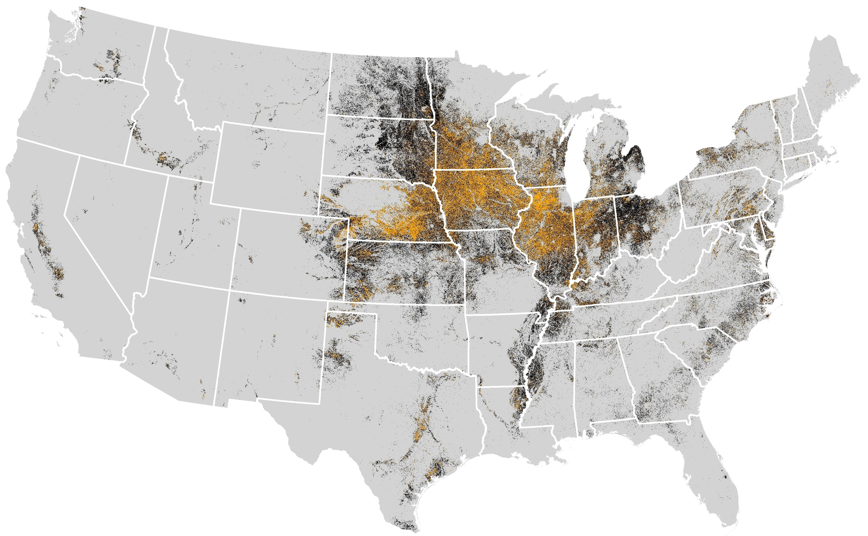
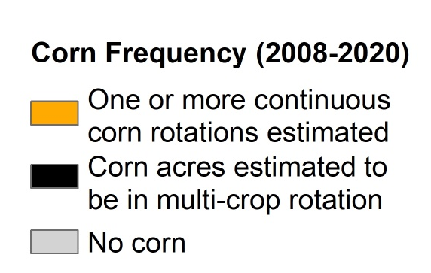
Cont corn map
Corn system (2008-2020)
Corn grown for two or more consecutive years
Corn grown in multi-crop rotation
No corn grown
Map courtesy of Jess Nelson
Data Source: https://www.nass.usda.gov/Research_and_Science/Cropland/Release/index.php
Notes:
This is a map of corn. The black shows where corn is grown in a multi-crop rotation, orange indicates places it’s grown in a monoculture. Corn, and the cropping systems it’s contained within, have a huge footprint in this country. Every state on this map has a corn dot. The way we manage corn affects everyone, and for my research I studied corn systems of the upper Midwest.

Slide 3
Selected take-aways
Notes:
I’m going to give you some selected take-aways from my research, but I also want to take a second to say I had a lot of support for this work. I want to thank NSF, NIFA, SARE, and the Henry A Wallace Chair for financially supporting me, and I want to thank my major advisors Matt Liebman and Sotiris Archontoulis and their labs, my committee, and my hourlies for making this all possible.
read em.

Slide 4
Selected take-aways
Longer rotations may benefit corn roots
Rotating corn reduces the risk of nitrate leaching
Cropping systems with more variation in planting dates have less weeds
Cover crops can effectively complement herbicides
(Cover crop termination – corn planting) window is where producers are exposed to the most risk
Notes:
read em.
I printed out the abstracts from my published work and put them on the back table, so if you are curious about learning more you can look back there. Note some of this work is still in review or is in the process of being submitted, so not everything is back there. But…which one of these do you all want to hear more about?

Slide 5
Longer rotations may benefit corn roots
Rotating corn reduces the risk of nitrate leaching
Cropping systems with more variation in planting dates have less weeds
Cover crops can effectively complement herbicides
(Cover crop termination – corn planting) window is where producers are exposed to the most risk
Notes:
Ok fine.

Slide 6
Notes:
here we go

Slide 7

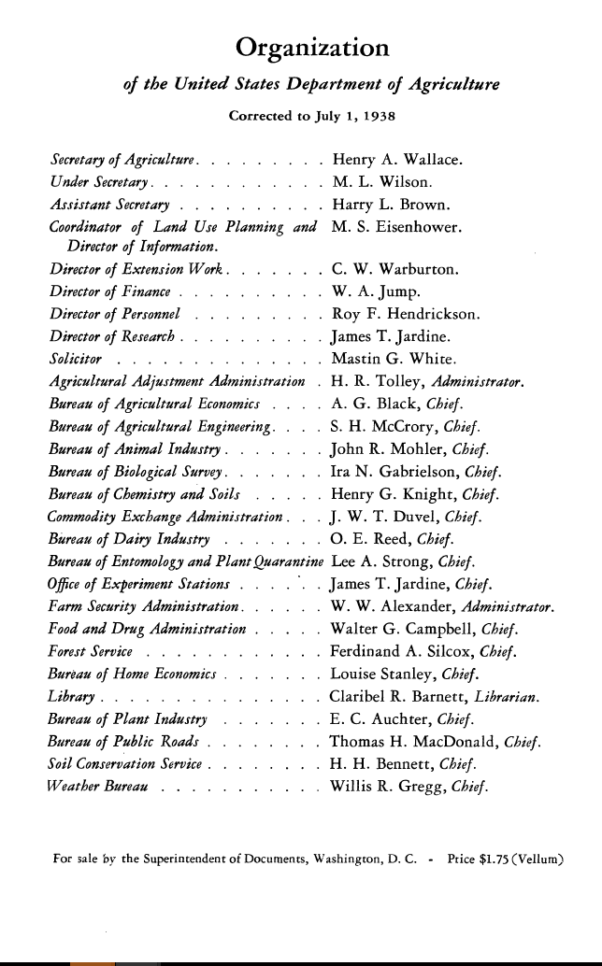
Notes:
This is a document that, with a slight change to the title, has a chapter I love.

Slide 8
People
Notes:
It was shared with me by one of my advisors, Matt Liebman, who is the Henry A Wallace Chair for Sustainable Agriculture here at ISU. That may or not be connected to why he shared it, but I hope the name Henry A Wallace sounds familiar to many of you.

Slide 9
Notes:
He is from Iowa, and was truly incredible. He was the secretary of agriculture, he could be called the inventor of hybrid corn and started Pioneer, which is now Corteva. And he commissioned this report because he was concerned with how we as a nation were treating our soils.

Slide 10
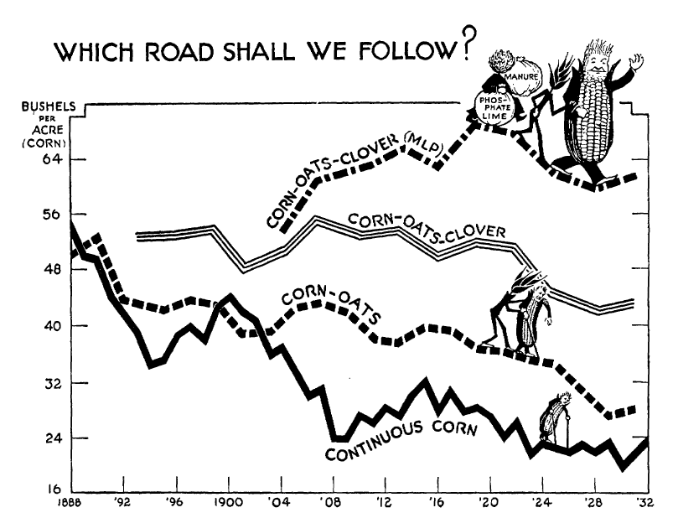
Notes:
There’s a chapter that is basically an ode to crop rotation. Now remember this was in 1938, so a lot of the crop rotation benefit was fertility-based. But even today, this phenomenon holds true.

Slide 11
Even today…

Slide 12
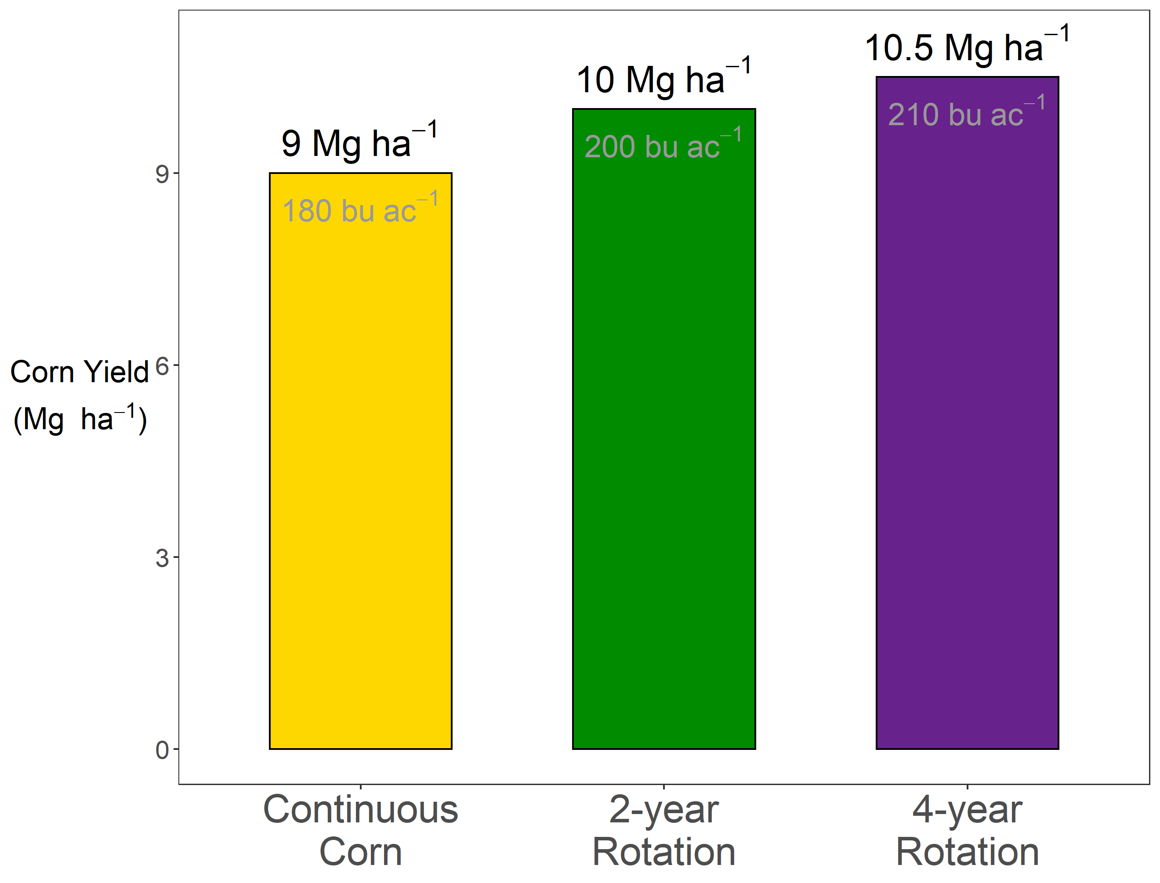



Slide 13
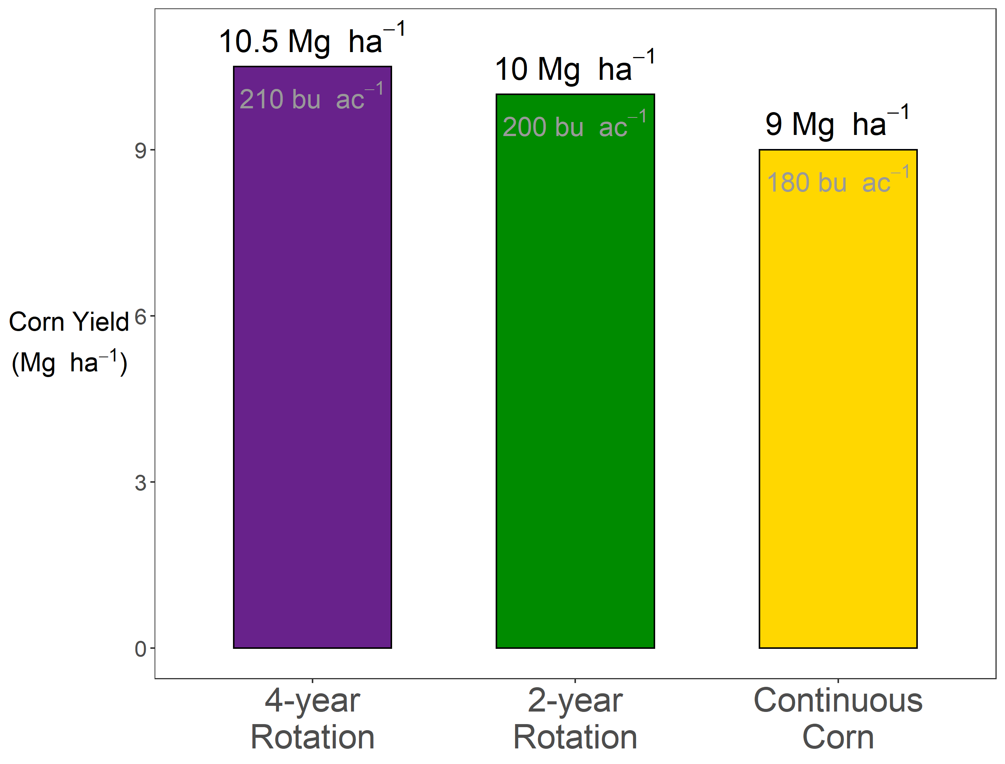

Slide 14
?

Slide 15
The Continuous Corn Penalty

Slide 16
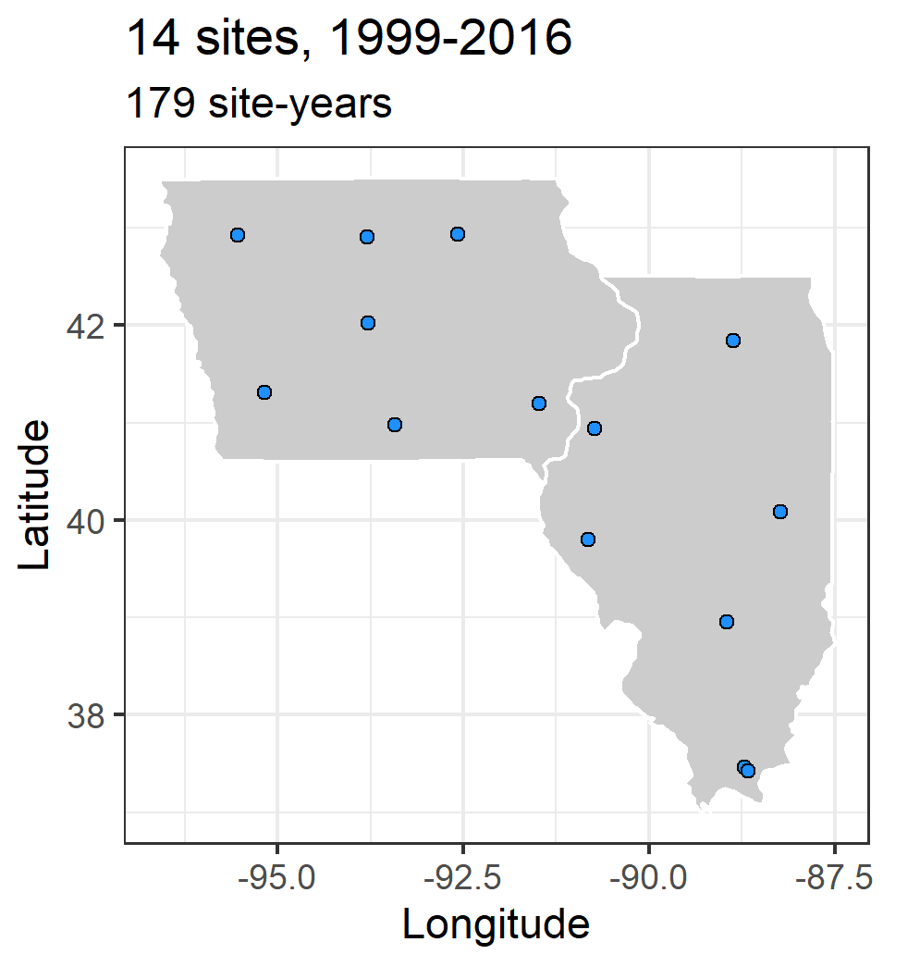
Notes:
Many states maintain a network of experiments looking at how corn responds to nitrogen. It takes a lot of work to run and maintain these long-term sites, and I’m grateful for John Sawyer, who is now retired from Iowa State University, and Emmerson Nafziger, also recently retired from the University of Illinois, for sharing this data to support my study of the continuous corn penalty. Each site has a corn-soybean rotation, and a continuous corn rotation, each receiving 3-7 different nitrogen treatments, and replicated at least three times. We can use these nitrogen-response curves to estimate the continuous corn penalty, which is what I’ll demonstrate now.

Slide 17
Notes:
Here is how corn responds to nitrogen. On the x-axis we have the amount of mineral nitrogen applied, and on the y-axis is corn yield. If you are growing corn in a field that was soybeans last year and you don’t put any nitrogen on it, you could expect about 7 Mg ha of corn yield. As you add more nitrogen, your corn yields go up, but they don’t go up forever. At some point they flatten out, and…

Slide 18
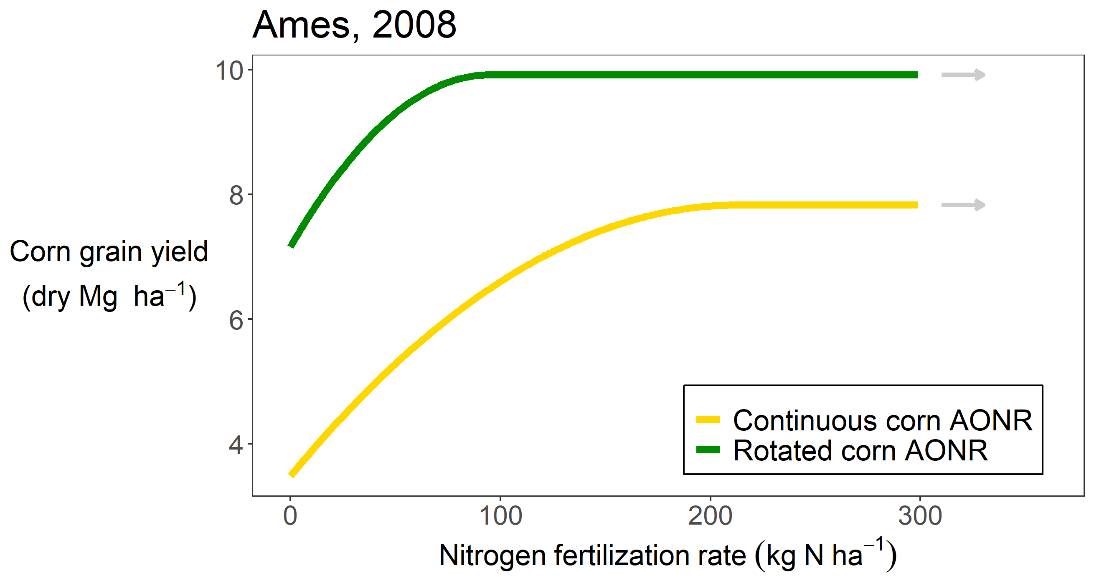
Notes:
Here is how corn responds to nitrogen. On the x-axis we have the amount of mineral nitrogen applied, and on the y-axis is corn yield. If you are growing corn in a field that was soybeans last year and you don’t put any nitrogen on it, you could expect about 7 Mg ha of corn yield. As you add more nitrogen, your corn yields go up, but they don’t go up forever. At some point they flatten out, and…

Slide 19
Notes:
Here is how corn responds to nitrogen. On the x-axis we have the amount of mineral nitrogen applied, and on the y-axis is corn yield. If you are growing corn in a field that was soybeans last year and you don’t put any nitrogen on it, you could expect about 7 Mg ha of corn yield. As you add more nitrogen, your corn yields go up, but they don’t go up forever. At some point they flatten out, and…

Slide 20
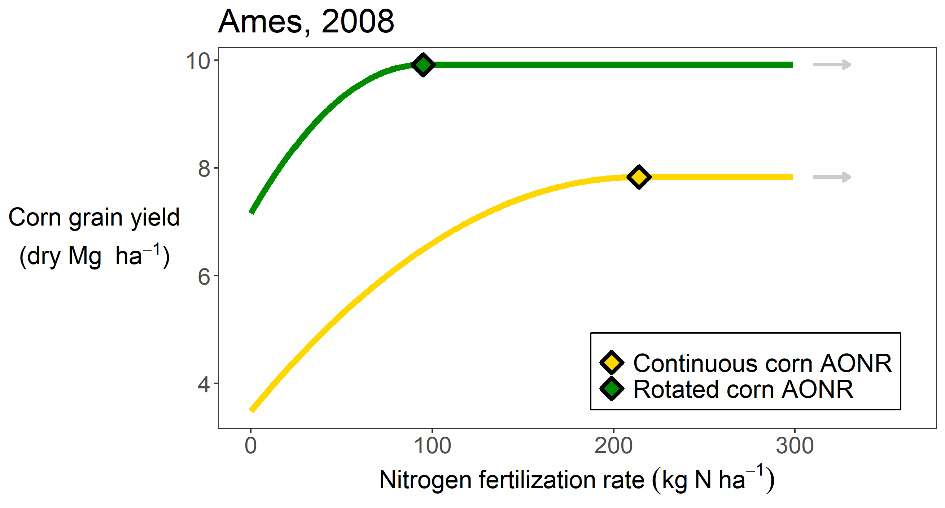
Notes:
That point has a special name – the agronomically optimum nitrogen rate, or AONR. In this case the AONR is about 100 kg of N per hectare. Note that this is ignoring economics. Nitrogen costs money, and depending on the price of corn it might not be worth it to add more nitrogen. But here we are only concerned with biophysical effects, but I did want to note in practice, economics are considered. The curve for corn grown following a corn crop looks different…

Slide 21
Notes:
There’s a lot of information here. Firstly, you can see that when you apply no nitrogen, the continuous corn yields less than the rotated corn. You can partially make up for that by applying more nitrogen, but you can also see you have to apply MORE nitrogen to get to the yield plateau in the continuous corn system. So you are applying MORE THAN TWICE the nitrogen to the continuous corn, your’re getting less yield, and …

Slide 22

Notes:
Some of my other research has shown you can overshoot the AONR in the rotated corn by about 50 kg/ha before your nitrate leaching really starts to skyrocket. In the continuous corn…

Slide 23
Notes:
You can only overapply fertilizer by about 20 kg N/ha before you have issues. So…

Slide 24
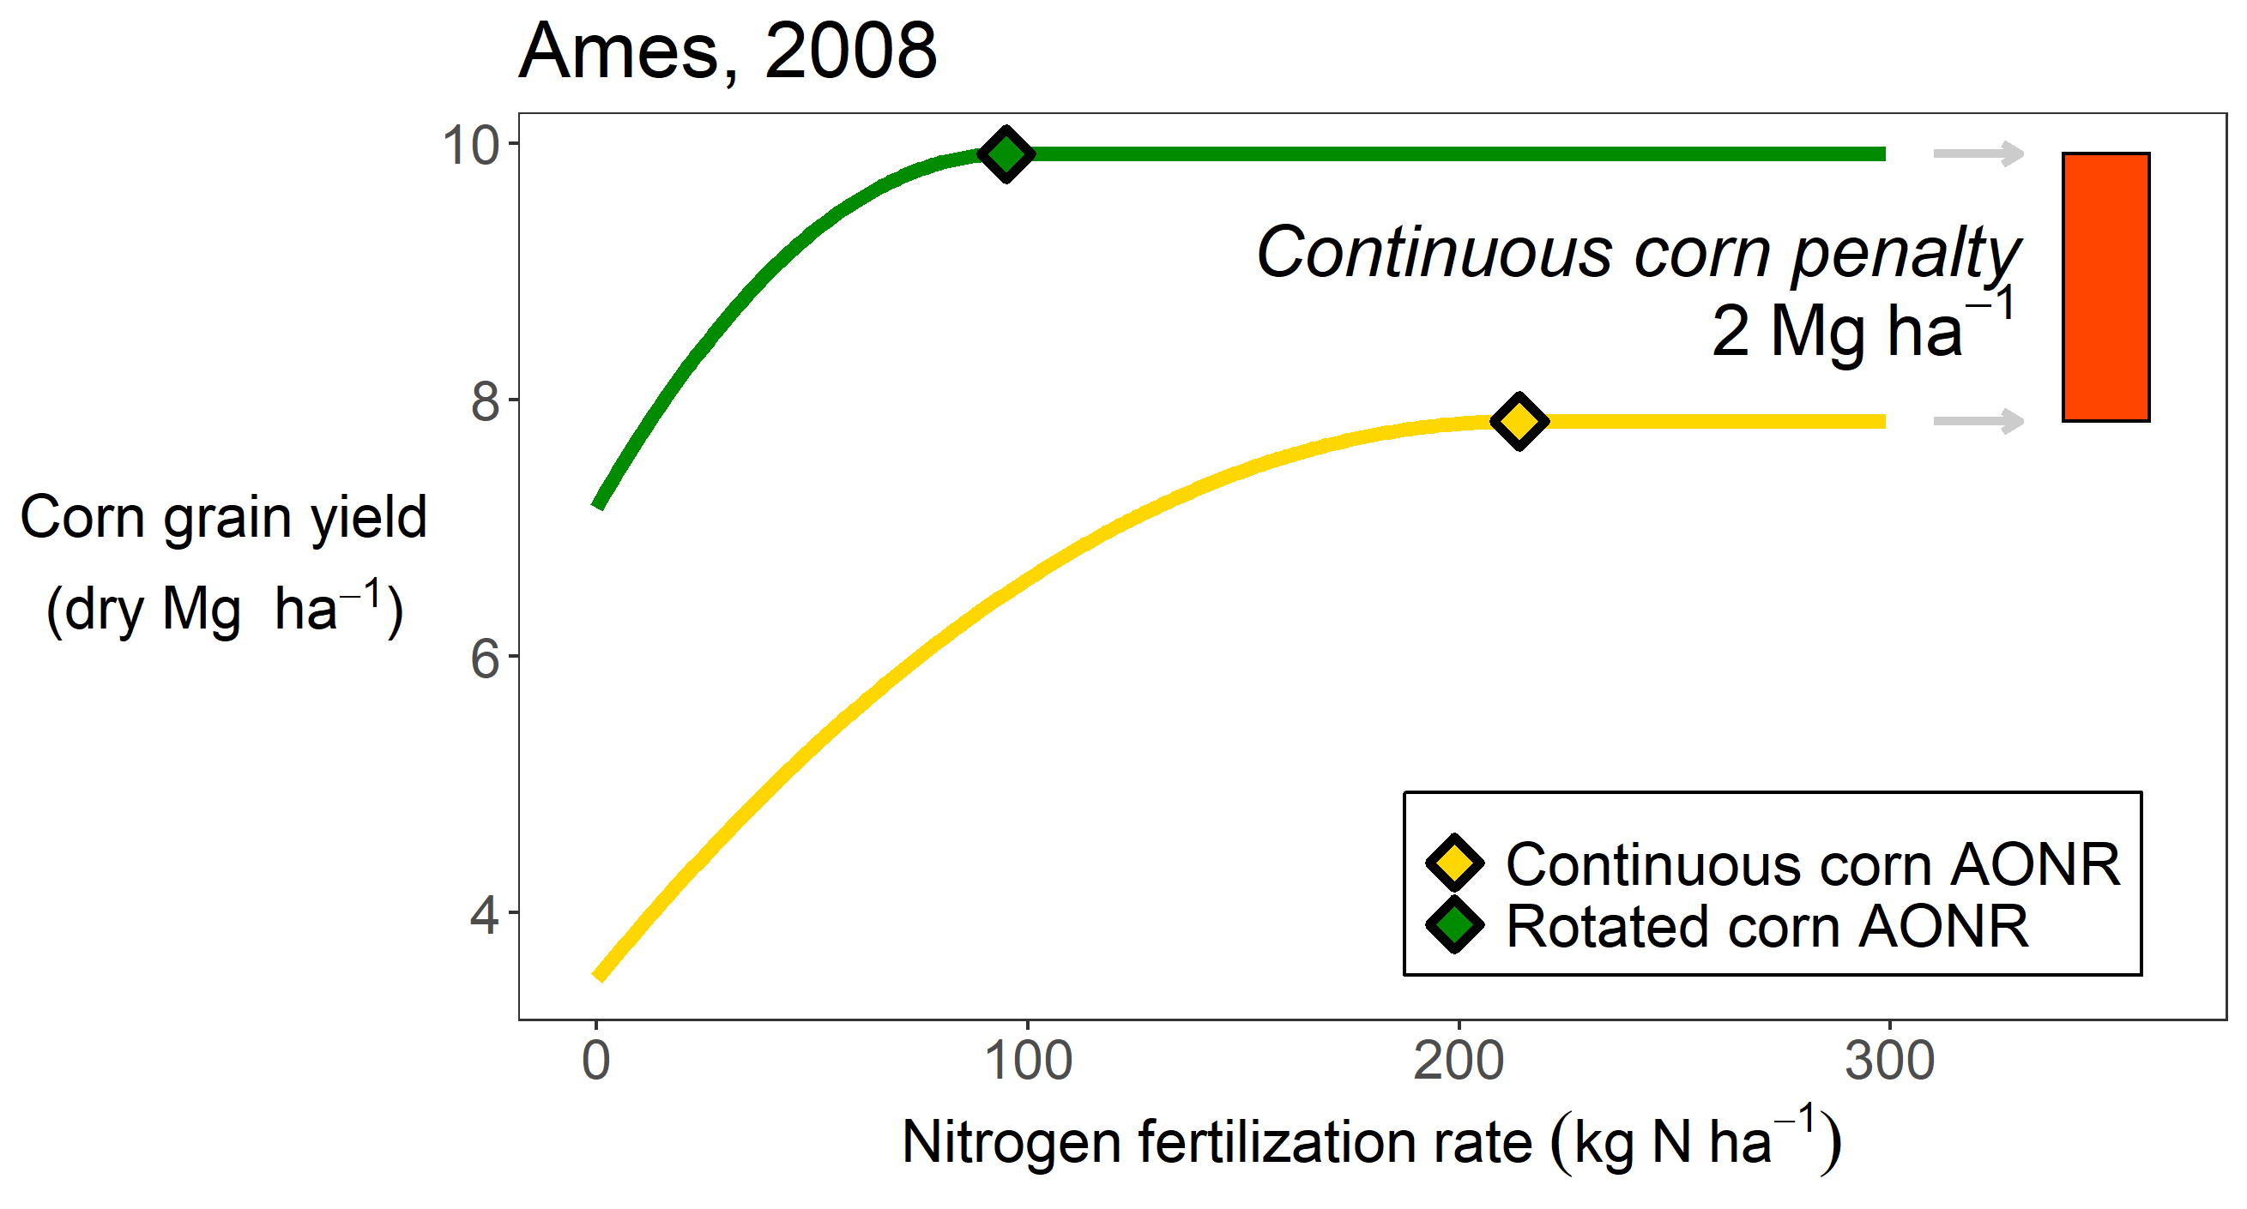
Notes:
To recap, in continuous corn systems you’re applying more nitrogen, getting less yield, and have a high risk of negatively affecting water quality. So when we talk about using land efficiently, and with minimal environmental impact, continuous corn presents major challenges. It’s important to understand why this is happening.

Slide 25
Cont corn map
Corn system (2008-2020)
Corn grown for two or more consecutive years
Corn grown in multi-crop rotation
No corn grown
Map courtesy of Jess Nelson
Data Source: https://www.nass.usda.gov/Research_and_Science/Cropland/Release/index.php
Notes:
You may remember this map from earlier. Remember the orange shows where corn has been subject to the continuous corn penalty. It represents about a third of the corn acres in the Midwest.

Slide 26
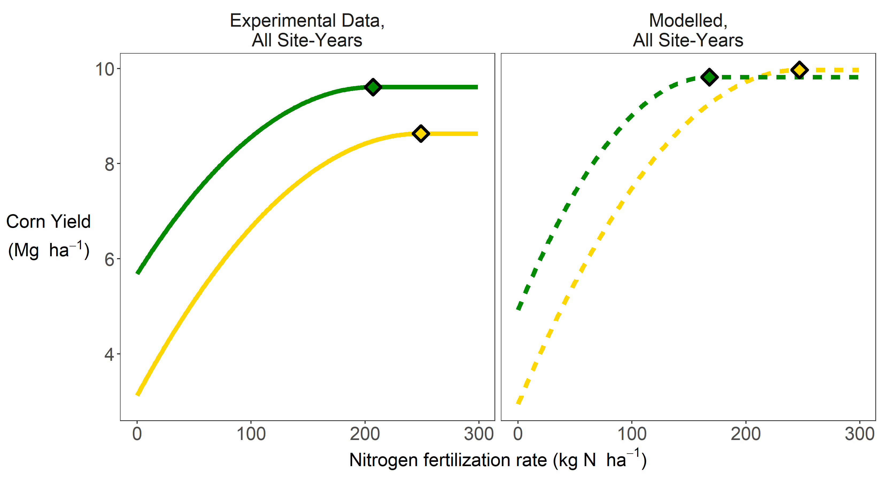
Notes:
On the left you can see what we’ve just been talking about, what experimental data looks like.

Slide 27
Notes:
On the left you can see what we’ve just been talking about, what experimental data looks like.

Slide 28
The Continuous Corn Penalty
Requires more nitrogen, yields less, higher risk of nitrate leaching
Affects a large amount of land
We need a way to model it

Slide 29
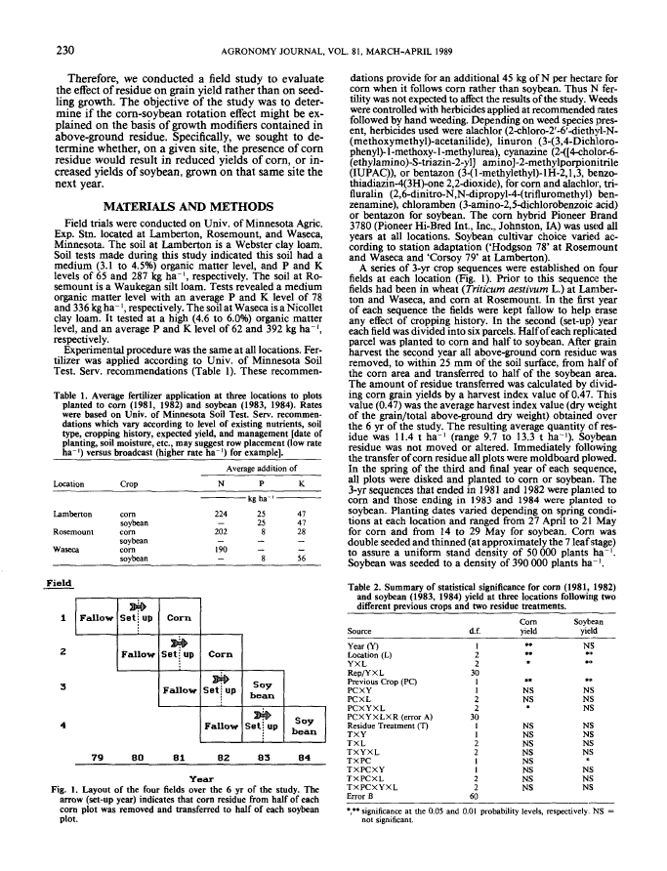

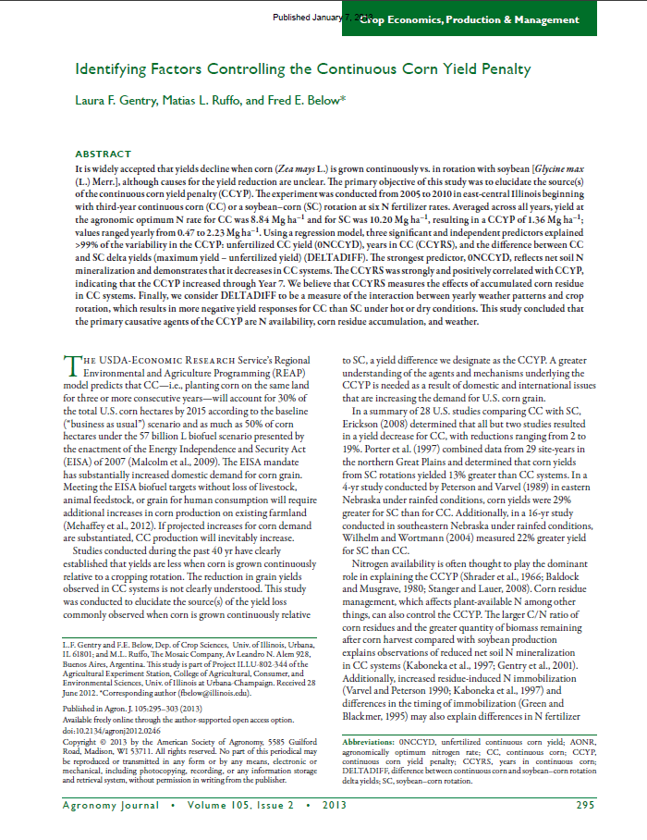
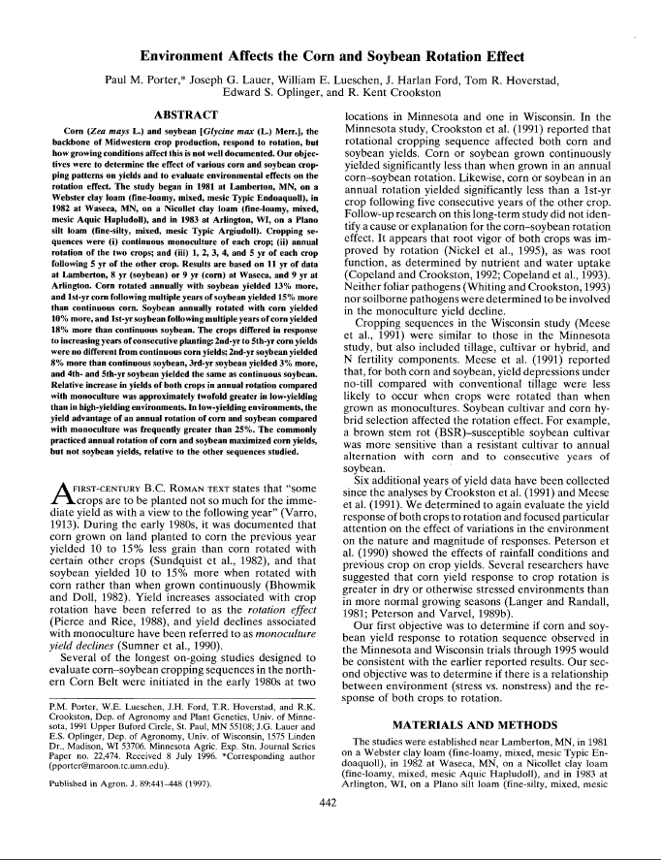
Notes:
To begin to tackle the problem we used a three-pronged approach. Literature review, modelling, and long-term multi-site replicated experimental data.

Slide 30

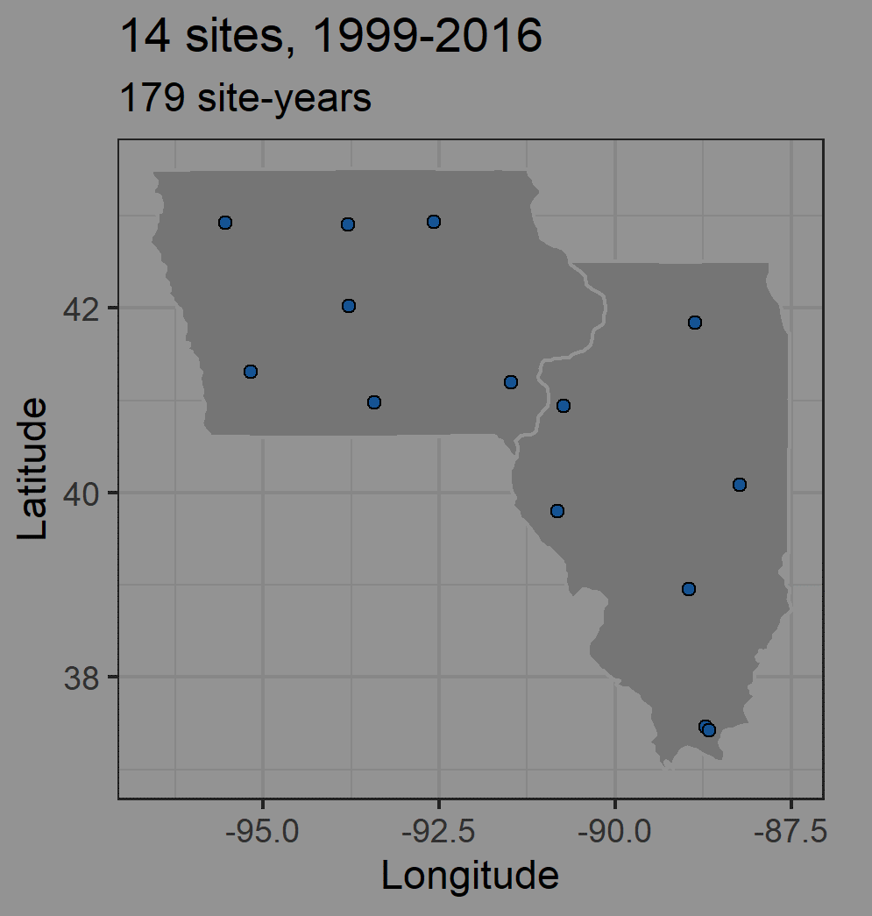
Notes:
To begin to tackle the problem we used a three-pronged approach. Literature review, modelling, and long-term multi-site replicated experimental data.

Slide 31
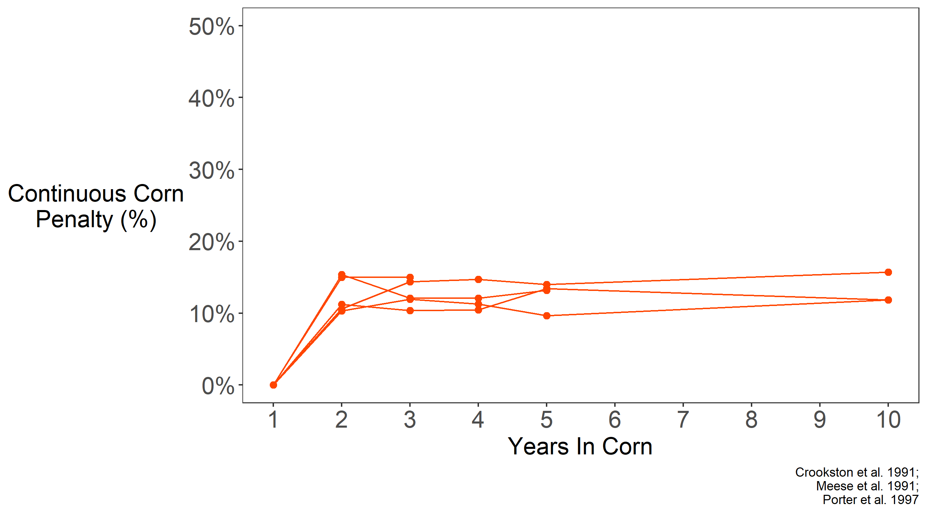
Notes:
The first question I had was whether there was evidence the penalty was related to the number of years in corn. This shows the penalty happens the first year you repeat a corn crop, but then remains steady after that. This means the effects don’t compound over time. This simplifies things, and means we only need to consider the previous year’s crop, rather than tracking long-term cropping system histories. This is just an example of information I garnered from literature, I’ll talk more about this later.

Slide 32

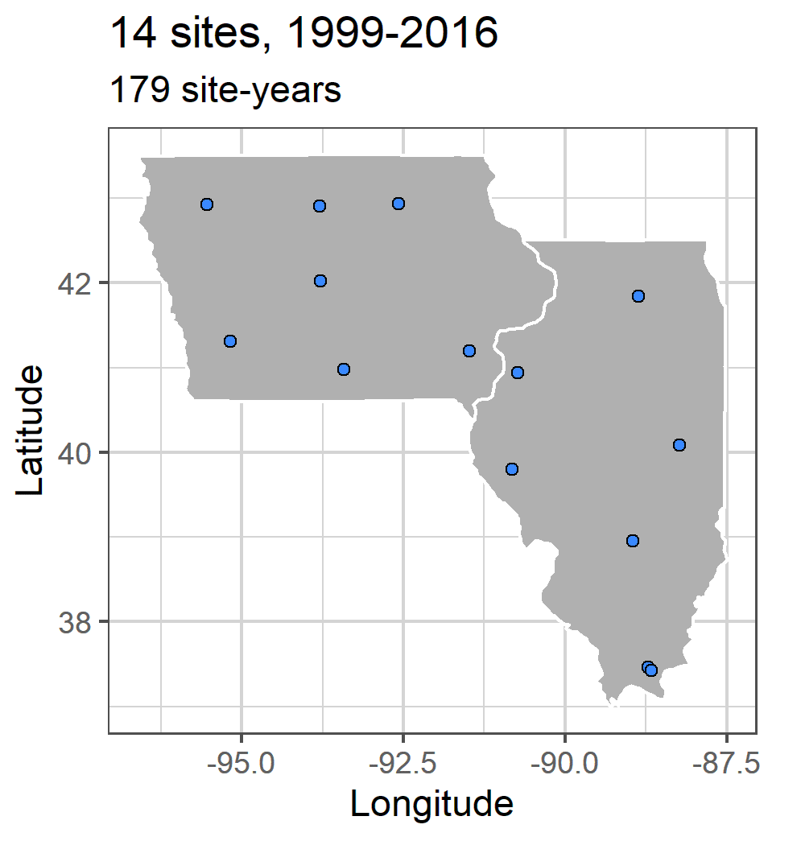
Notes:
Now let’s return to the experimental data I mentioned earlier.

Slide 33
Notes:
Many states maintain a network of experiments looking at how corn responds to nitrogen, like that figure I showed earlier. John Sawyer and Emmerson Nafziger, both now retired, managed Iowa and Illinois’ sites, respectively. Each site had a corn-soybean rotation, and a continuous corn rotation, each receiving 3-7 different nitrogen treatments, and replicated at least three times. We used these nitrogen-response curves to estimate the continuous corn penalty for each year at each site.

Slide 34
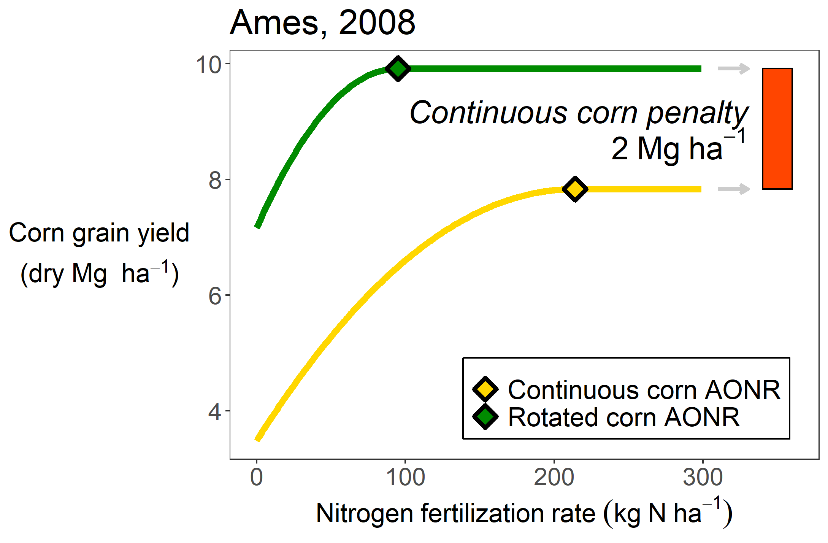
Notes:
So the set of curves I showed earlier came from one year in Ames. I did this curve-fitting analysis for each year at each site in order to approximate the continuous corn penalty.

Slide 35
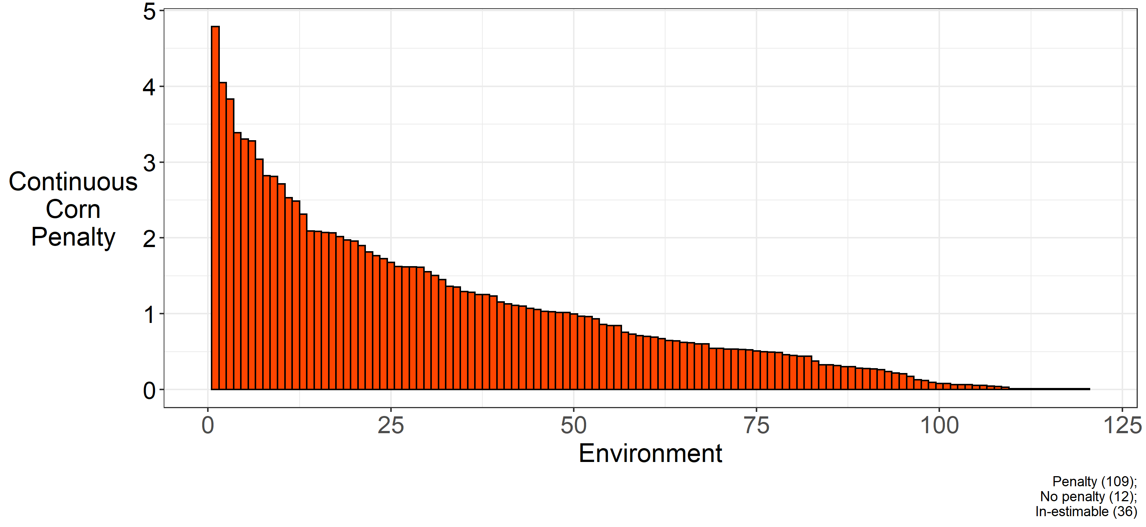
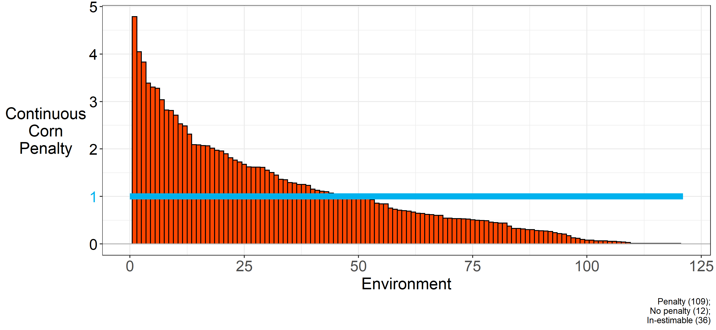
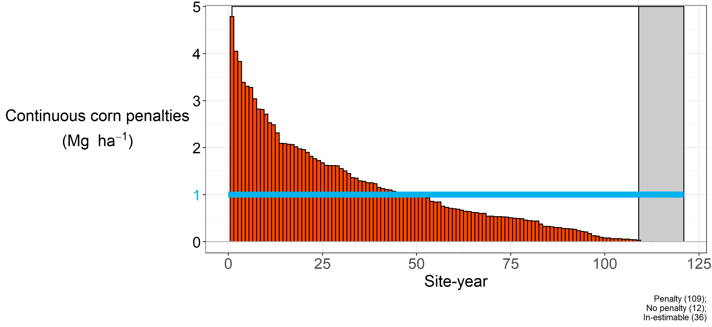
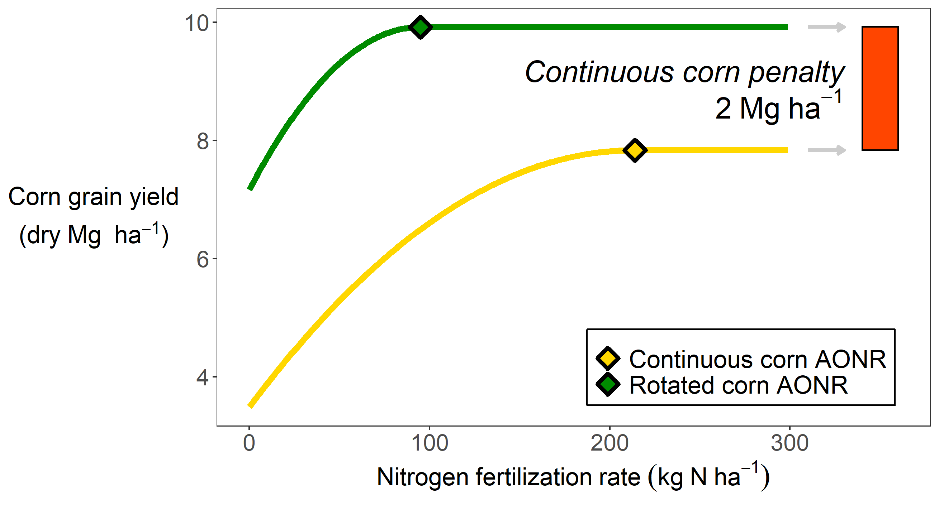
Notes:
Again here’s a little reminder of how I’m calculating this penalty. Each bar represents one environment, or site-year, and I’ve ordered them from largest to smallest. In 90% of the environments, continuous corn yielded less than rotated corn even at high nitrogen application rates. In the other 10%, adding more nitrogen completely closed the yield gaps.

Slide 36
Notes:
The blue line represents the statistical mean, at 1 Mg ha-1 (roughly 20 bushels).

Slide 37
~10% yield penalty
Notes:
This corresponded to a mean of about 10% yield penalty for growing corn continuously.

Slide 38
The Continuous Corn Penalty
Effect does not compound over time
Exists in literature
Exists in our field sites

Slide 39
Hypothesis
Insufficient soil water recharge following corn
Altered nitrogen cycling
More variable stand
Seedling death
Delayed emergence
Foliar disease
Compromised root growth
Compromised root function
Decreased early plant growth
Notes:
I created a list of hypotheses of causal mechanisms. These are things that have been suggested, some have been tested but only greenhouses or one or two seasons, and in some cases came from asking agronomists and farmers what they thought. I’m one person. I can’t do experiments in the field to test all of these hypotheses. But using a model to do experiments would allow me to look at all of them.

Slide 40
Notes:
I’m

Slide 41
Open-source
Team of support
Used world-wide
Validated in Midwest

Slide 42
Hypothesis | Model Approach
Insufficient soil water recharge following corn
Altered nitrogen cycling
More variable stand
Seedling death
Delayed emergence
Foliar disease
Compromised root growth
Compromised root function
Decreased early plant growth
Notes:
I can now think about how to test these using a model.

Slide 43
Hypothesis | Model Approach
Insufficient soil water recharge following corn | Look at soil moisture
Altered nitrogen cycling
More variable stand
Seedling death
Delayed emergence
Foliar disease
Compromised root growth
Compromised root function
Decreased early plant growth
Notes:
For each of these hypotheses, I could often use the model to do an experiment to test them. For example, I could calibrate a model to our experimental data, then simply look at the soil moisture predictions in the continuous corn and rotated corn, and see if they differed.

Slide 44
Hypothesis | Model Approach
Insufficient soil water recharge following corn | Look at soil moisture
Altered nitrogen cycling
More variable stand
Seedling death
Delayed emergence
Foliar disease
Compromised root growth
Compromised root function
Decreased early plant growth
Notes:
I then extracted a list of hypotheses. These are things that have been suggested, some have been tested but only greenhouses or one or two seasons, and in some cases came from asking agronomists and farmers what they thought.

Slide 45
Hypothesis | Model Approach
Insufficient soil water recharge following corn | Look at soil moisture
Altered nitrogen cycling | In progress
More variable stand | In progress
Seedling death
Delayed emergence
Foliar disease
Compromised root growth
Compromised root function
Decreased early plant growth

Slide 46
Hypothesis | Model Approach
Insufficient soil water recharge following corn | Look at soil moisture
Altered nitrogen cycling | In progress
More variable stand | In progress
Seedling death | Decrease planting density
Delayed emergence
Foliar disease
Compromised root growth
Compromised root function
Decreased early plant growth
Notes:
I then extracted a list of hypotheses. These are things that have been suggested, some have been tested but only greenhouses or one or two seasons, and in some cases came from asking agronomists and farmers what they thought.

Slide 47
Hypothesis | Model Approach
Insufficient soil water recharge following corn | Look at soil moisture
Altered nitrogen cycling | In progress
More variable stand | In progress
Seedling death | Decrease planting density
Delayed emergence | Increase planting depth
Foliar disease
Compromised root growth
Compromised root function
Decreased early plant growth
Notes:
I then extracted a list of hypotheses. These are things that have been suggested, some have been tested but only greenhouses or one or two seasons, and in some cases came from asking agronomists and farmers what they thought.

Slide 48
Hypothesis | Model Approach
Insufficient soil water recharge following corn | Look at soil moisture
Altered nitrogen cycling | In progress
More variable stand | In progress
Seedling death | Decrease planting density
Delayed emergence | Increase planting depth
Foliar disease | Decrease RUE
Compromised root growth
Compromised root function
Decreased early plant growth
Notes:
I then extracted a list of hypotheses. These are things that have been suggested, some have been tested but only greenhouses or one or two seasons, and in some cases came from asking agronomists and farmers what they thought.

Slide 49
Hypothesis | Model Approach
Insufficient soil water recharge following corn | Look at soil moisture
Altered nitrogen cycling | In progress
More variable stand | In progress
Seedling death | Decrease planting density
Delayed emergence | Increase planting depth
Foliar disease | Decrease RUE
Compromised root growth | Decrease root exploration factor
Compromised root function
Decreased early plant growth
Notes:
I then extracted a list of hypotheses. These are things that have been suggested, some have been tested but only greenhouses or one or two seasons, and in some cases came from asking agronomists and farmers what they thought.

Slide 50
Hypothesis | Model Approach
Insufficient soil water recharge following corn | Look at soil moisture
Altered nitrogen cycling | In progress
More variable stand | In progress
Seedling death | Decrease planting density
Delayed emergence | Increase planting depth
Foliar disease | Decrease RUE
Compromised root growth | Decrease root exploration factor
Compromised root function | Decrease root absorption factor
Decreased early plant growth
Notes:
I then extracted a list of hypotheses. These are things that have been suggested, some have been tested but only greenhouses or one or two seasons, and in some cases came from asking agronomists and farmers what they thought.

Slide 51
Hypothesis | Model Approach
Insufficient soil water recharge following corn | Look at soil moisture
Altered nitrogen cycling | In progress
More variable stand | In progress
Seedling death | Decrease planting density
Delayed emergence | Increase planting depth
Foliar disease | Decrease RUE
Compromised root growth | Decrease root exploration factor
Compromised root function | Decrease root absorption factor
Decreased early plant growth | Decrease maximum kernel number

Slide 52
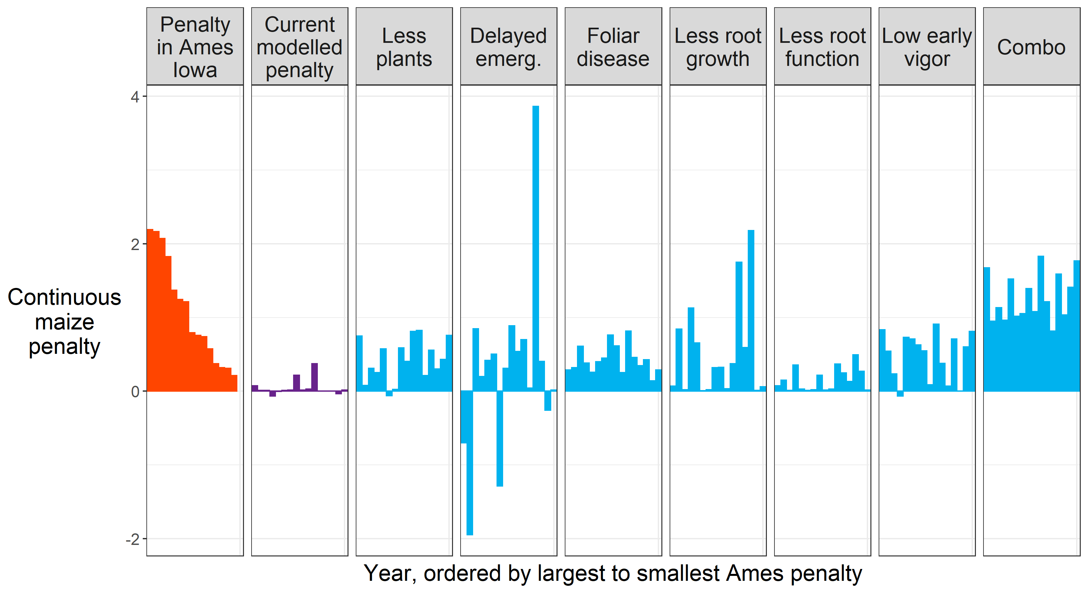
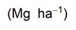
Notes:
So you’ve seen this type of figure before. It’s the penalty in Ames Iowa, ordered from largest to smallest.

Slide 53
Notes:
Here is the penalty the model predicts without any parameter changes. You can see it essentially DOESN’T predict a penalty, like I showed you earlier.

Slide 54
Notes:
Here’s the first virtual experiment I did, decreasing the number of plants in the continuous corn. Now what we can do is simply say ‘does this look like this?’ I can assess this mathematically of course, but it is a visual exercise as well. I can do this for each of the virtual experiments.

Slide 55
Notes:
Here’s the first virtual experiment I did, decreasing the number of plants in the continuous corn. Now what we can do is simply say ‘does this look like this?’ I can assess this mathematically of course, but it is a visual exercise as well. I can do this for each of the virtual experiments.

Slide 56
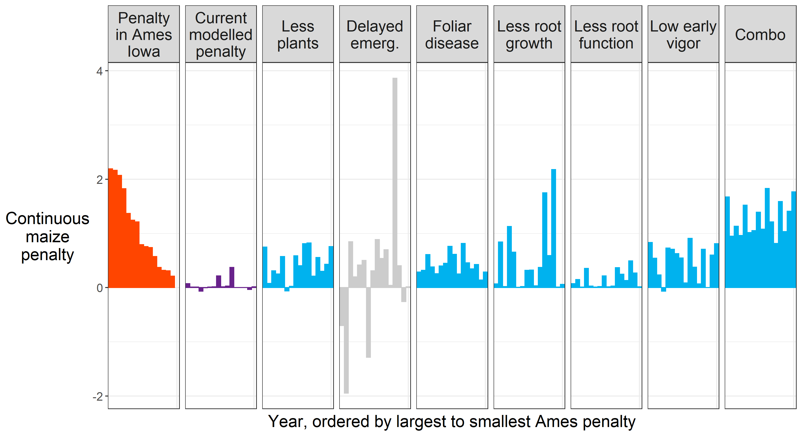
Notes:
You can see this exercise allowed us to eliminate delayed germination as a consistent driver of the continuous corn penalty. That’s not to say that in some years it may be important, but the effect of delayed germination on yields depends heavily on the weather, and could actually increase yields in some years. If we eliminate this as a possibility, and we combine

Slide 57

Notes:
You can see the pattern doesn’t match exactly, but the mean modelled penalty starts to match the experimentally observed mean. This indicates it might be necessary to implement several parameter changes to capture the continuous corn penalty in a model.

Slide 58
Notes:
Just to note, the only of these that has some field data to support it is the root effects. In addition to helping us identify candidate mechanisms, we were also able to create a list of suggested measurements that would help support or refute the hypotheses, and help constrain which parameters to focus on for the models.

Slide 59
The Continuous Corn Penalty
Maximum rooting depth, specific root length
Growth analysis
Yield components
Surface residue at planting

Slide 60
A Side Note

Slide 61
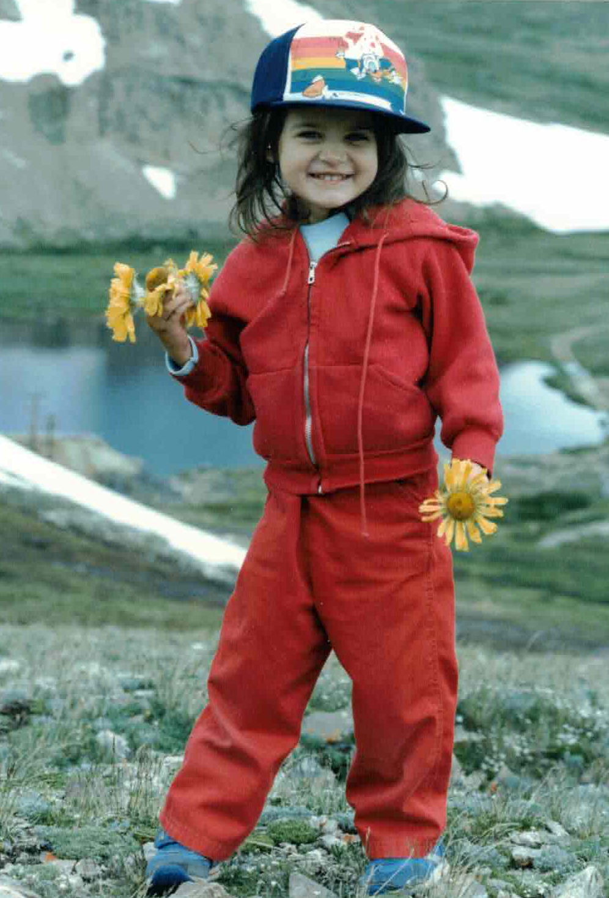

Slide 62
How can agriculture be done such that
the farmer,
their community,
society,
and the environment…
…all benefit?

Slide 63
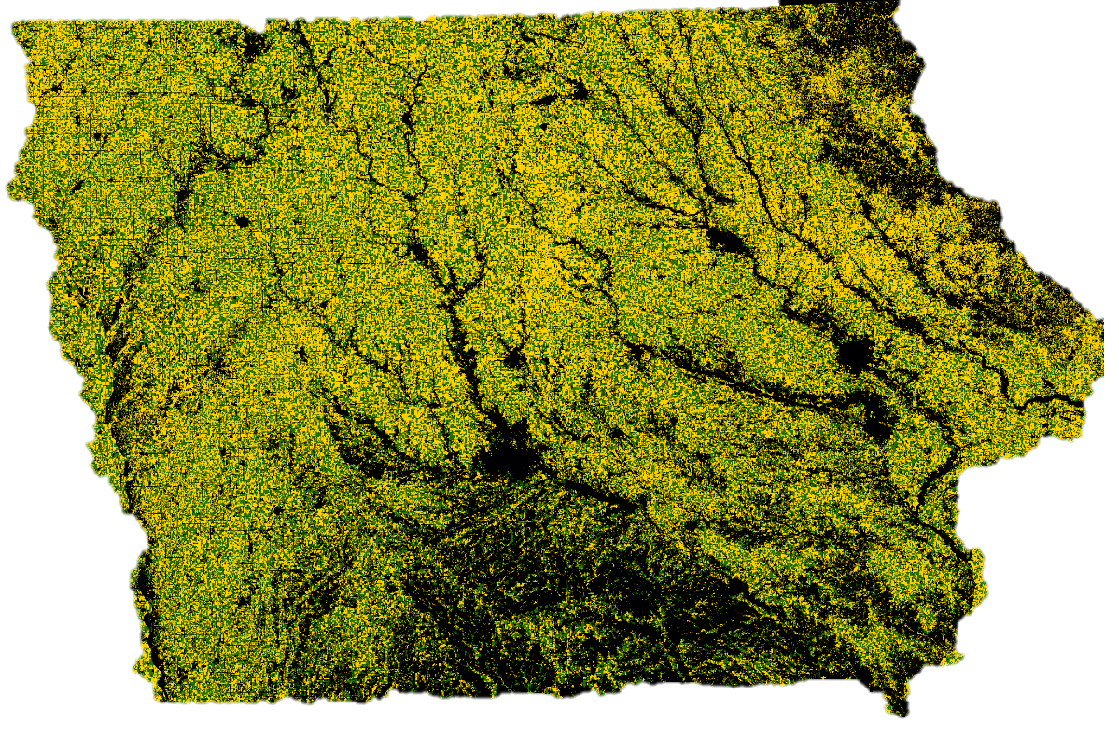
Notes:
This is a map I made that shows corn in yellow, soybean in green, and anything else in black. Literally, any other land cover is black. Roads, buildings, parks, forests, rivers. This state is defined by corn and soybean. I should say that I like Iowa, and it’s truly an incredible place to study agriculture. But I do wonder…

Slide 64
…the farmer,
their community,
society,
and the environment?
Notes:
Does all this corn and soybean benefit farmers, their communities, society, and the environment? PAUSE. We could grow a lot of different crops in Iowa.

Slide 65
What if we grew more crops?
Notes:
So what if we did?

Slide 67

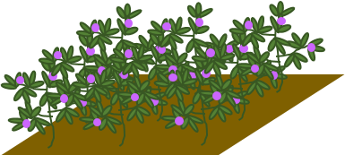

Slide 68
The Rotation Effect

Slide 69
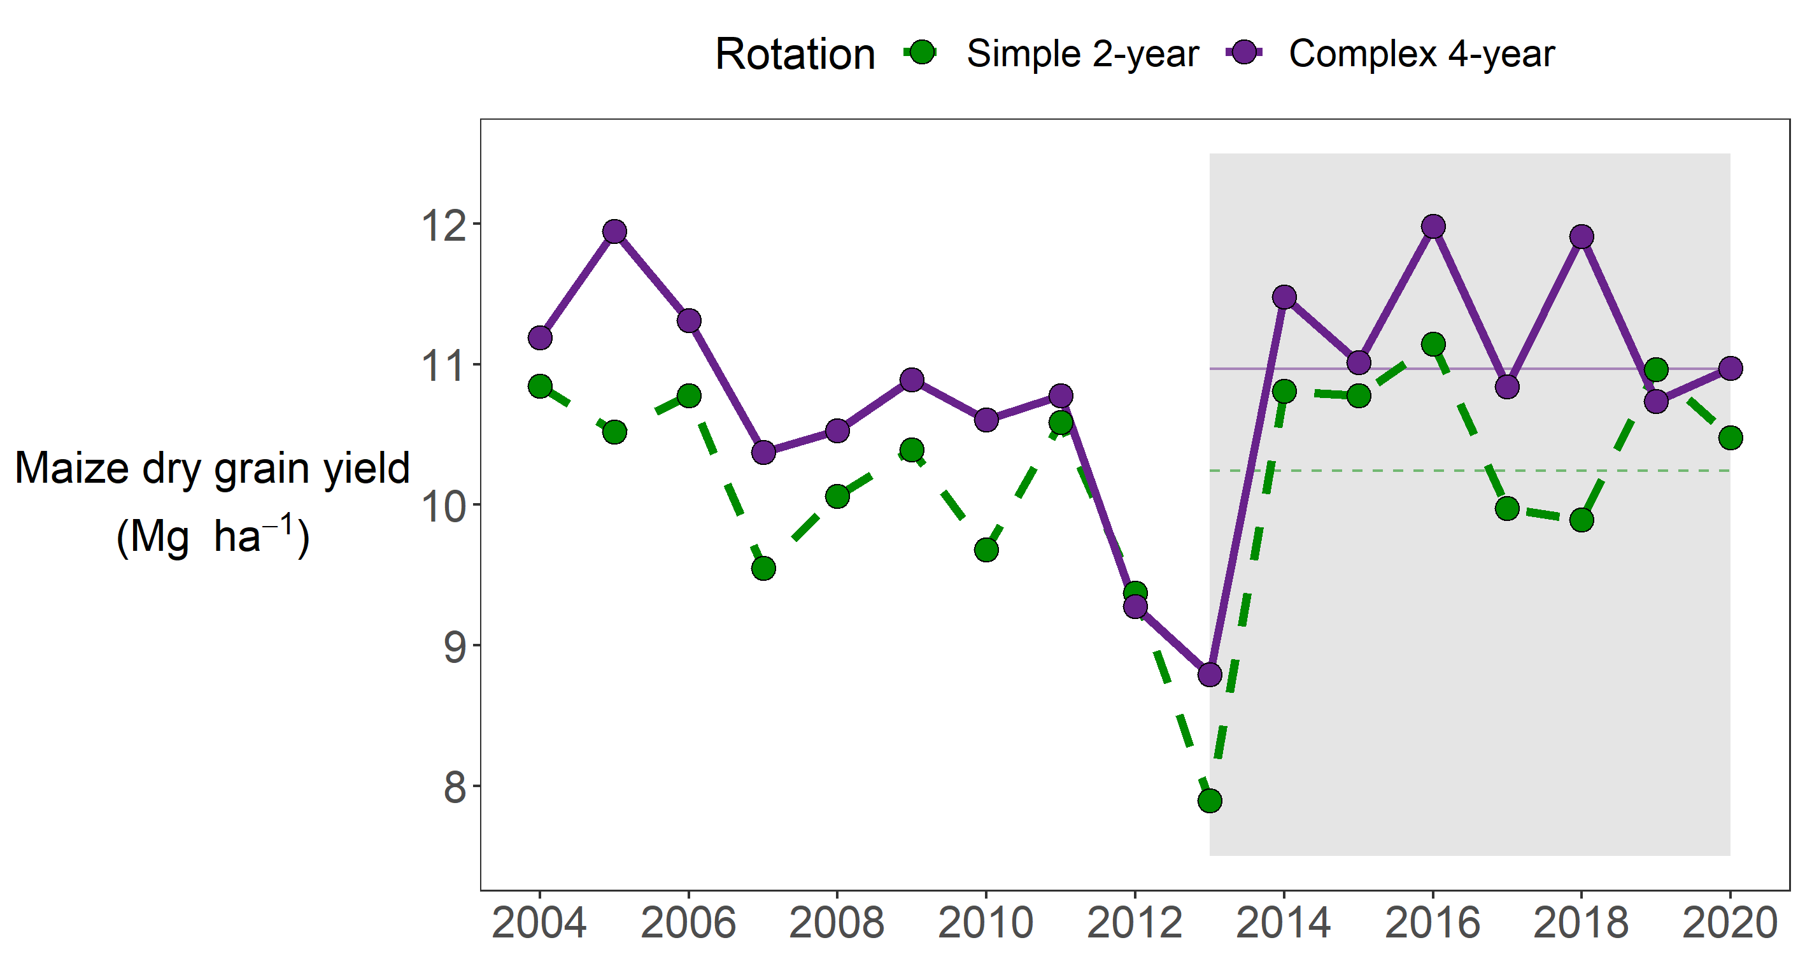
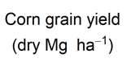

Slide 70
Suite of field measurements
Grain yields
Above ground biomass
500-kernel weights
Residue
Soil macro/micronutrient analysis 0-1 m depth
Soil penetration resistance
Soil moisture
Depth to water table
Rooting depth
Root mass

Slide 71
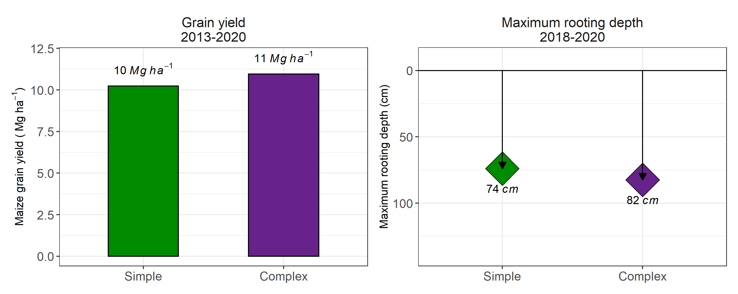

Slide 72
The Rotation Effect
Deeper, cheaper roots
Not clear if it’s physical, chemical, and/or biological
Corn plant is more resilient?

Slide 73
Anything but simple.
Notes:
To many people, Iowa’s landscape may seem simple. On one hand, it is, and it has some consequences I would label as negative, and I would argue we should be striving to do anything to make it more complex, on a lot of levels. On the other hand, though this system may seem simple, it really is anything but. There is nuance to Iowa’s system, and I spent the first half of this presentation talking about how complicated it is to study the difference between a monoculture of corn, and corn rotated with just one other crop. Cropping systems, even seemingly simple ones, are wonderfully complex, and studying them requires complex tools that themselves are, anything but simple. It’s my hope that when you leave this presentation you think of Iowa a little bit differently. Thank you, and what questions do you have for me?

Slide 74
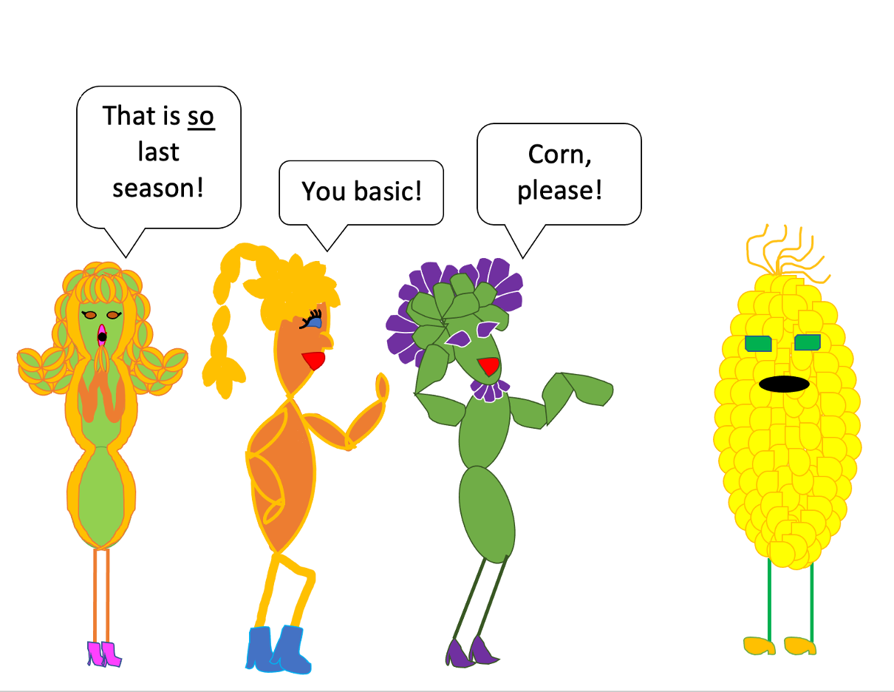
Created by Heather Pasley

Slide 75
Bonus slides…

Slide 76
2018-present
8. Nichols et al. (in prep) Roots as drivers of the rotation effect in maize?
7. Nichols et al. (in prep) Using models to unravel causal mechanisms of the continuous maize penalty
6. Nichols & MacKenzie (in prep) Decision analysis to target cover crop research priorities in Central Iowa
5. Nichols et al. (in review) Winter cover cropping effects on soil water storage vary by site: Field measurements and a proposed causal model
4. Nichols et al. (2020). Effect of long-term cover-cropping on weed seedbanks. Frontiers in Agronomy
3. Nichols et al. (2020) Cover crops and weed suppression in the U.S. Midwest: A meta‐analysis and modeling study. Agricultural and Environmental Letters
2. Weisberger*, Nichols*, Liebman (2019) Does diversifying crop rotations suppress weeds? A meta-analysis. PloS one
1. Nichols et al. (2019) Maize root distributions strongly associated with water tables in Iowa, USA Plant and Soil
5. Bird, Nichols, et al. (in review). Means, motive, and opportunity: A stakeholder analysis method to understand likelihood of action in food-energy-water systems. Elementa
4. Pasley, Nichols, et al. (2021). Rotating maize reduces the risk and rate of nitrate leaching. Environmental Research Letters.
3. Archontoulis, Castellano, Licht, Nichols, et al. (2020) Predicting crop yields and soil-plant nitrogen dynamics in the US Corn Belt. Crop Science
2. Liebman & Nichols (2020) Cropping system redesign for improved weed management: A modeling approach illustrated with giant ragweed (Ambrosia trifida). Agronomy
1. Martinez-Feria, Nichols, et al. (2019) Can multi-strategy management stabilize nitrate leaching under increasing rainfall? Environmental Research Letters
Notes:
I arrived at ISU in January 2018. On the left are my first-authored publications, and on the right my co-authored publications since I’ve arrived. I’m showing you this to tell you I have a lot of things I’ve done that I want to tell you about. But I can’t.
So I made a short list of some of the key take-aways I have from my work.

Slide 77
table of some years effects?

Slide 78



DataFEWSion Traineeship
Henry A. Wallace Chair for Sustainable Agriculture

Slide 79
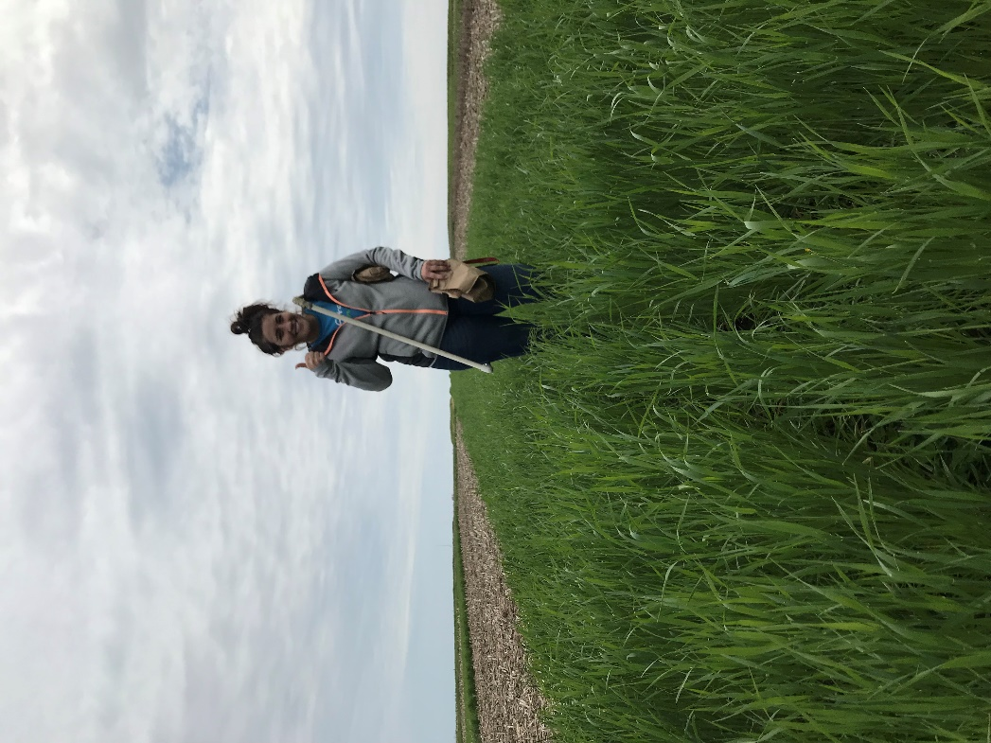
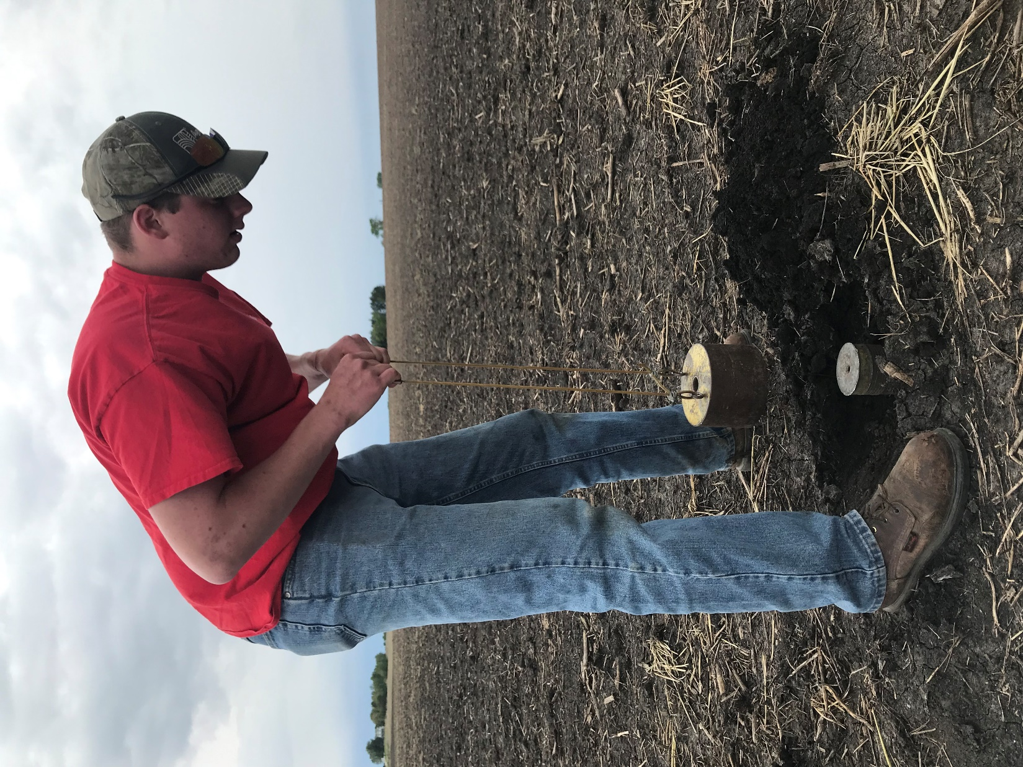
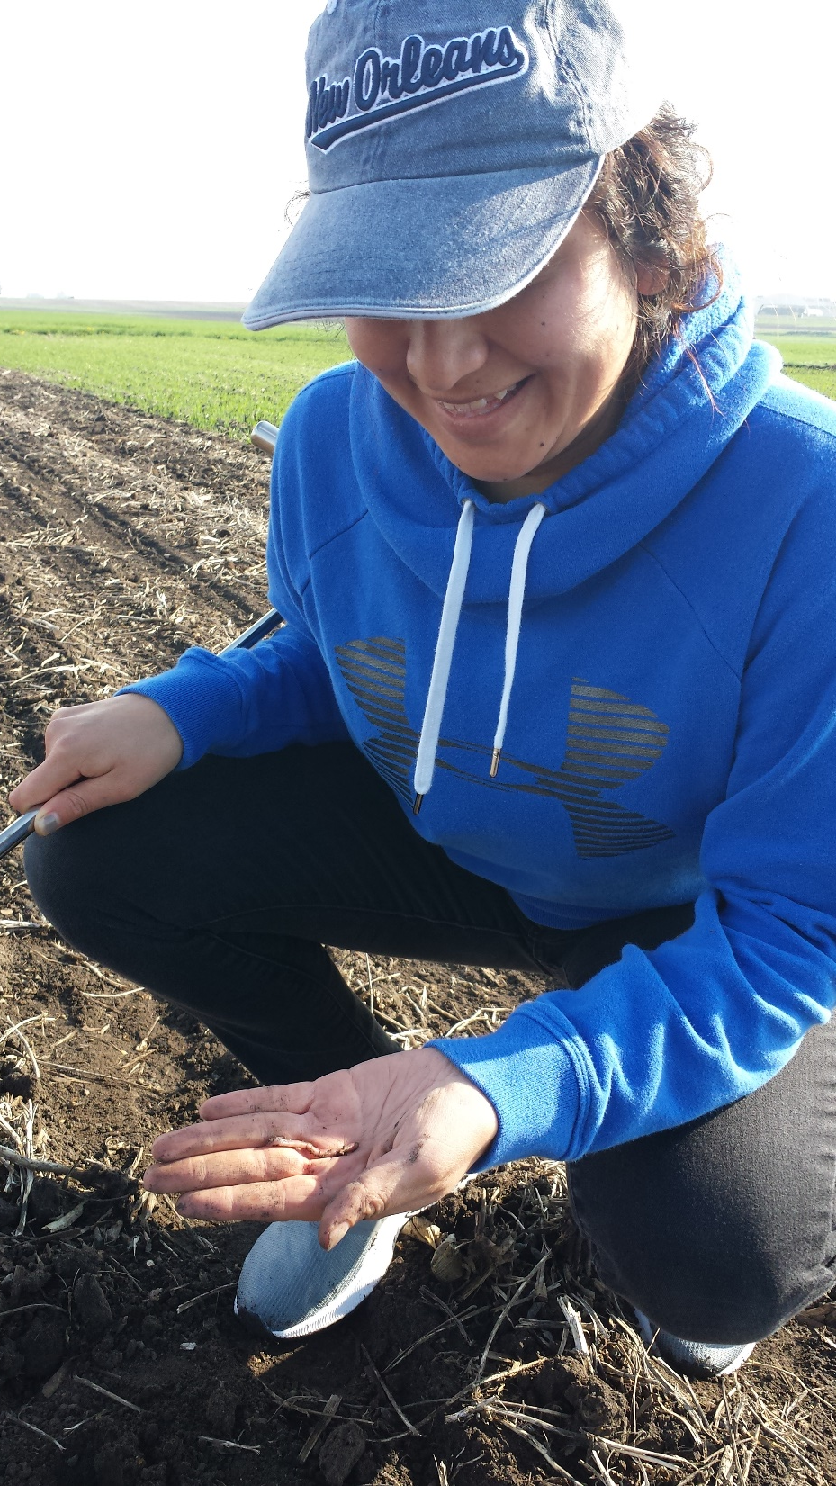

Slide 80
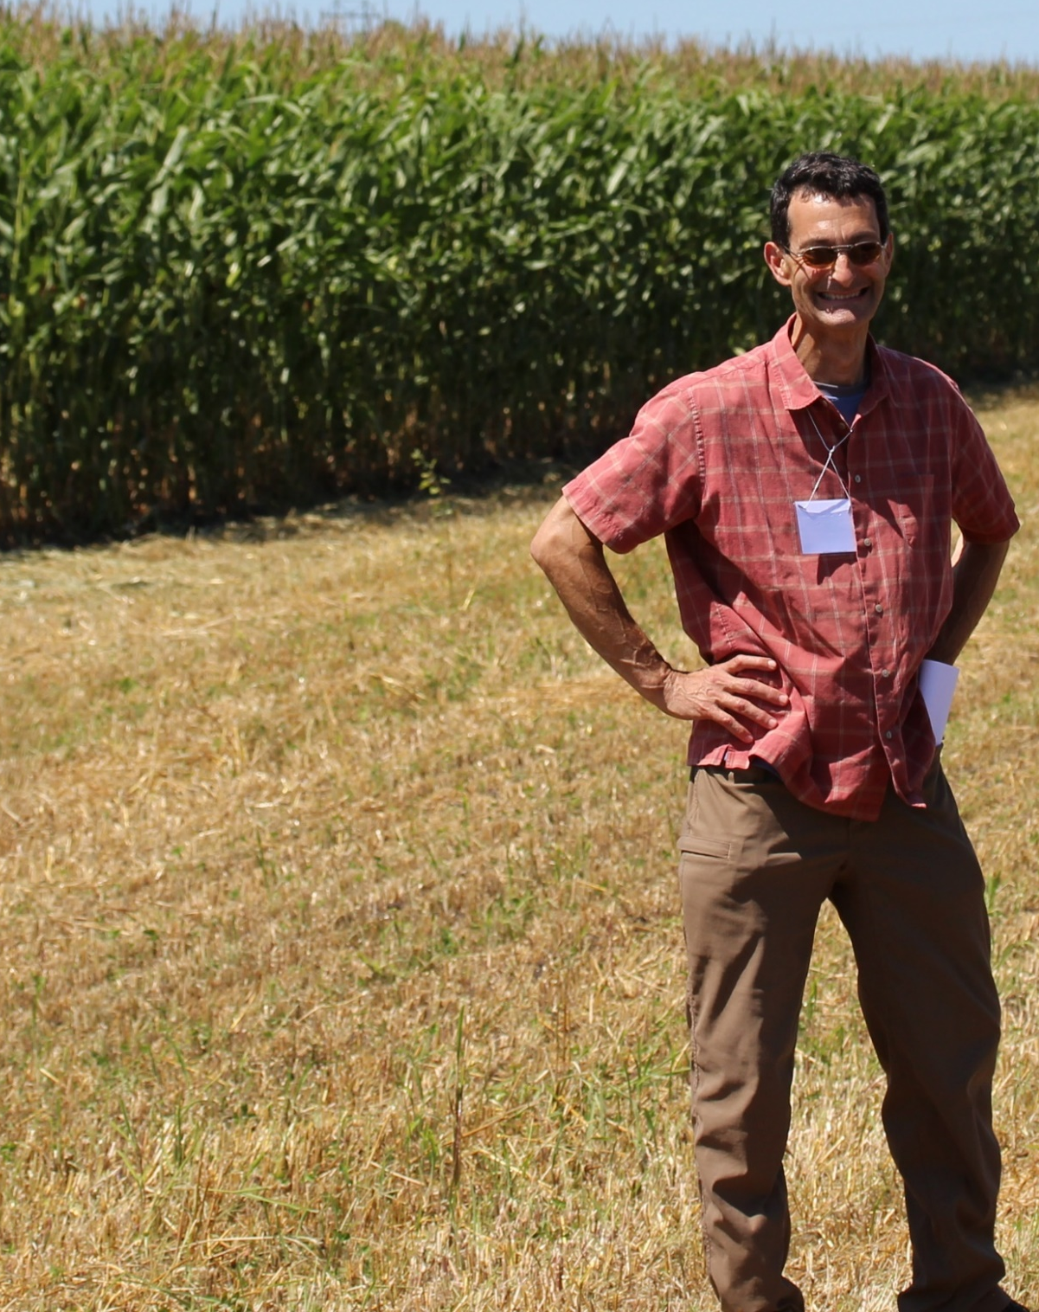
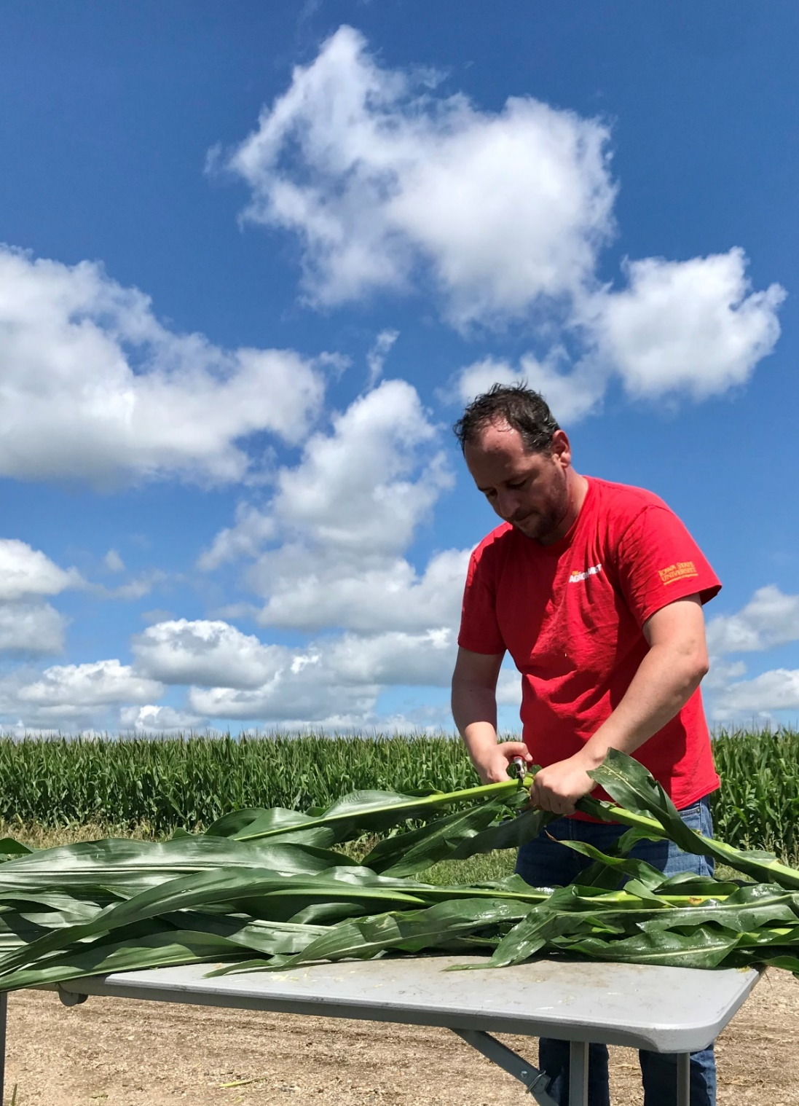
Matt Liebman
Professor
Agronomy Dept.
Iowa State University
Sotirios Archontoulis
Associate Professor
Agronomy Dept.
Iowa State University

Slide 81
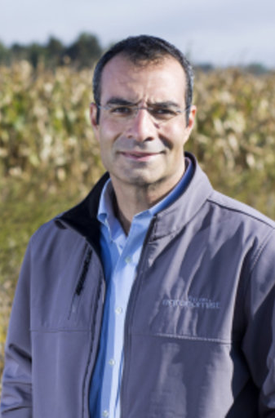


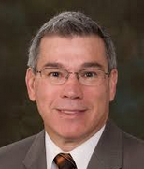
Mike Castellano
Associate Professor
Agronomy Dept.
Iowa State University
Jarad Niemi
Associate Professor
Statistics Depart.
Iowa State University
Jerry Hatfield
Fomer Laboratory Director
National Lab for Ag & the Env
USDA (retired!)
Neil Huth
Principal Research Scientist
CSIRO, Australia

Slide 82
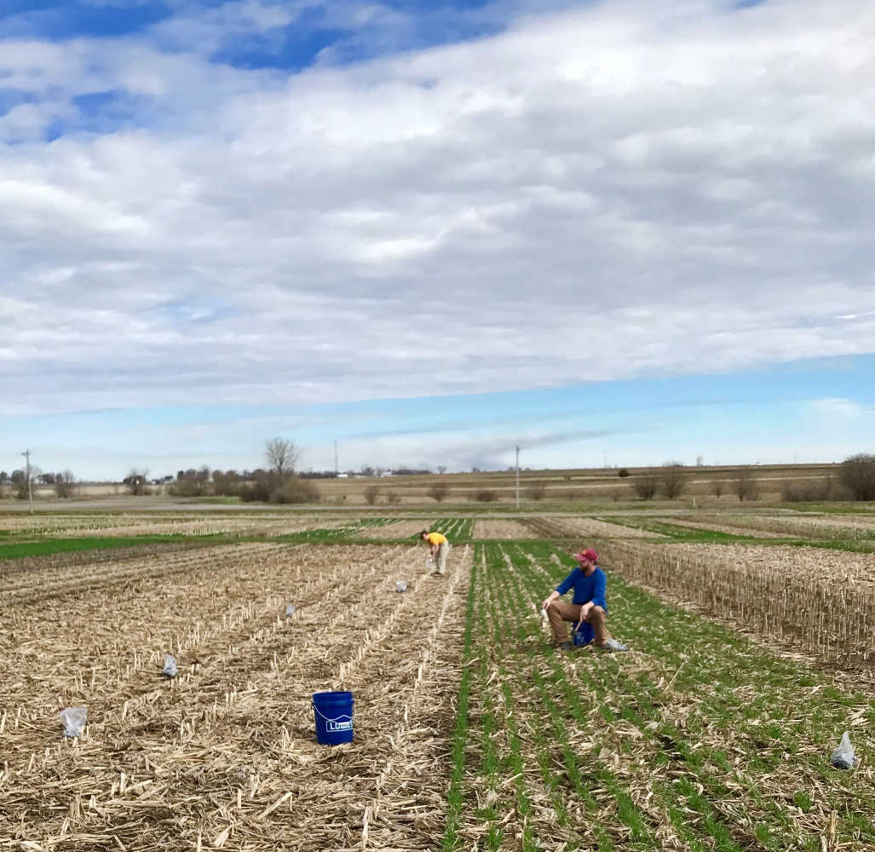
Archontoulis Lab (past and present)
Liebman Lab (past and present)
Miguez Lab + Theo
Stefan Gailans, Lydia English, Sarah Carlson, Ranae Dietzel, Fernando Miguez, Philip Dixon, Katherine Goode, Miranda Tilton, Heike Hofman, Mitch Baum, Caio dos Santos, Jess Nelson
Mary D, Deb, Kevin, Mary Anne, Rita, Patrick, Michelle, Cynthia, the friendly building staff of Agronomy Hall

Slide 83
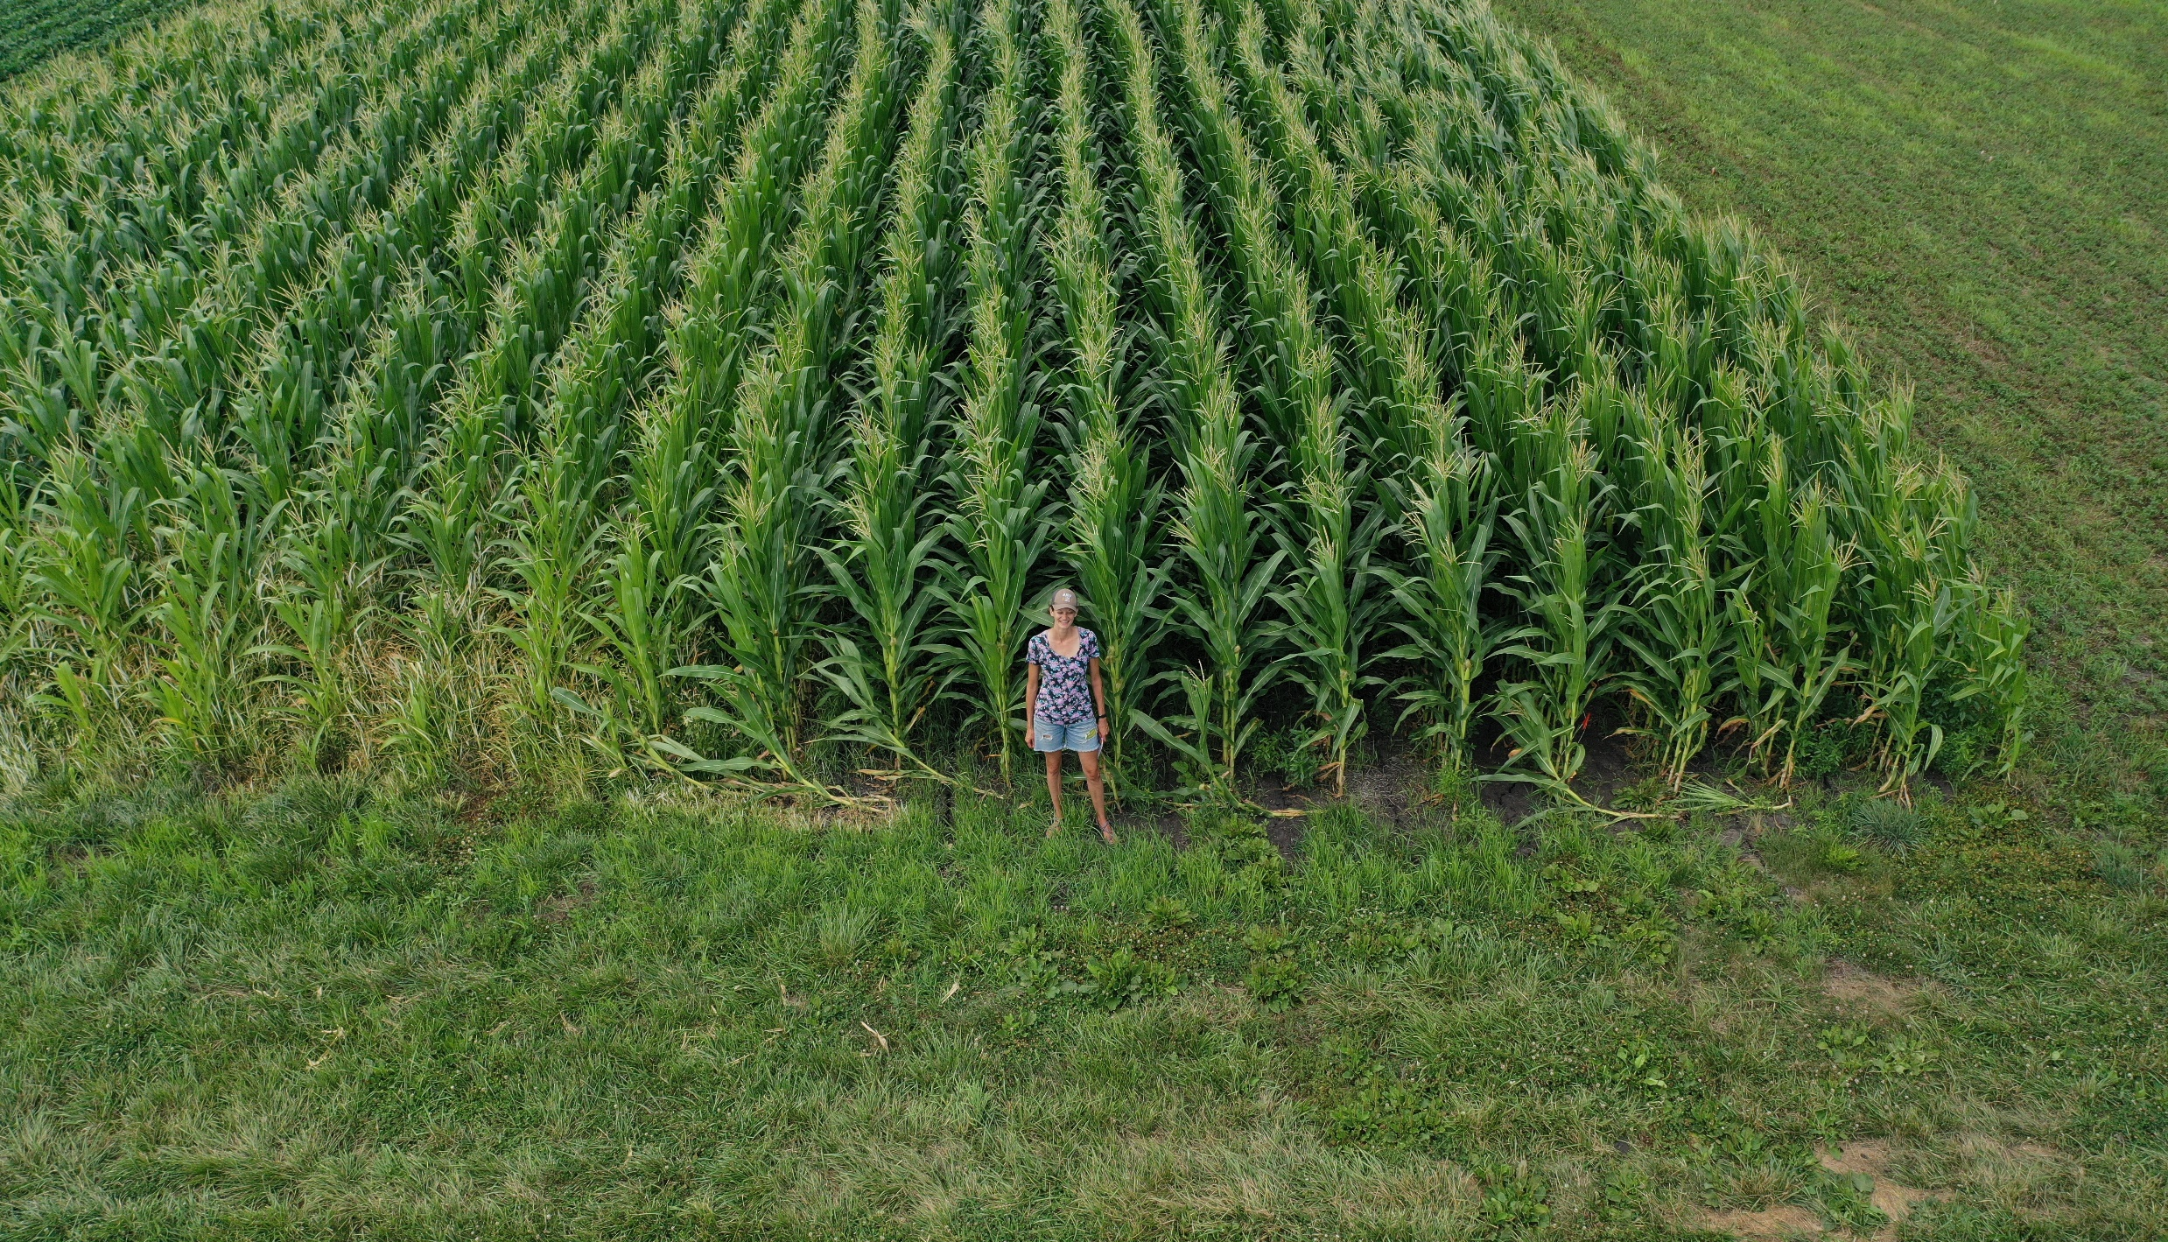

Slide 84
Extras

Slide 85
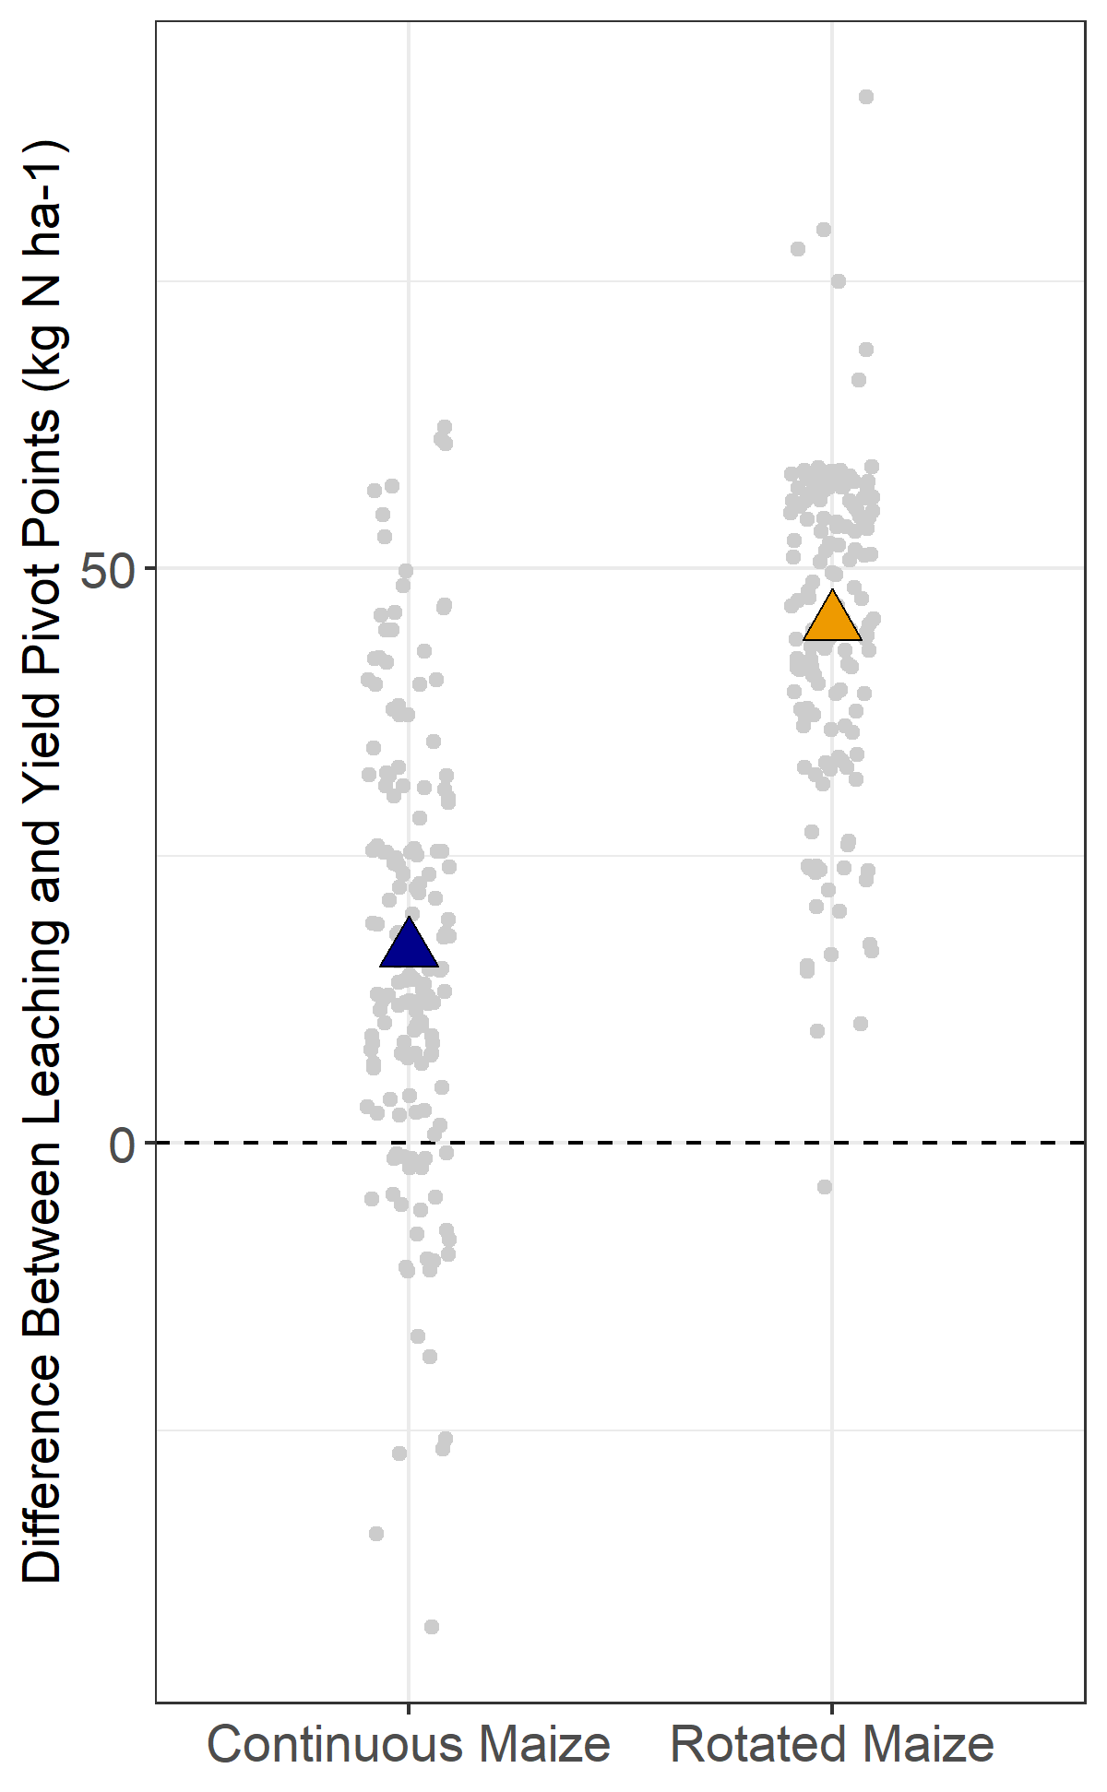

Slide 86
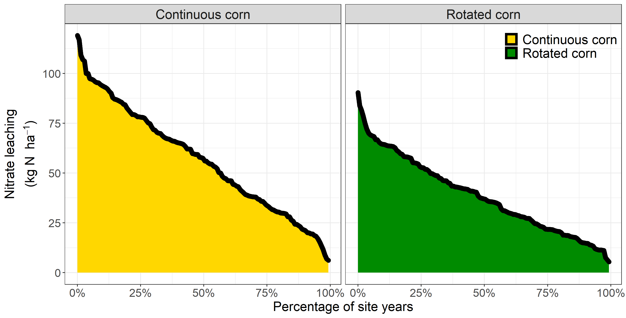
8 sites, 151 site-years, modeled nitrate leaching at 150 and 200 kg N application

Slide 87
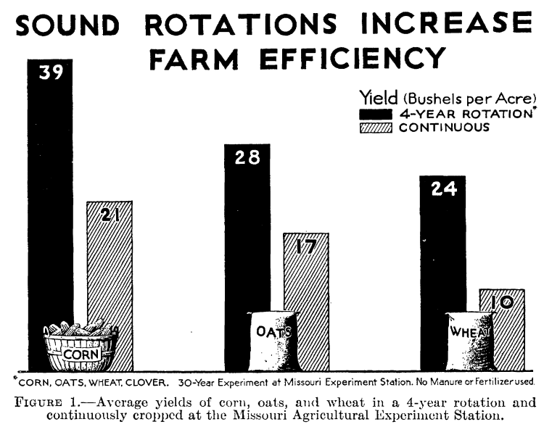


Slide 88
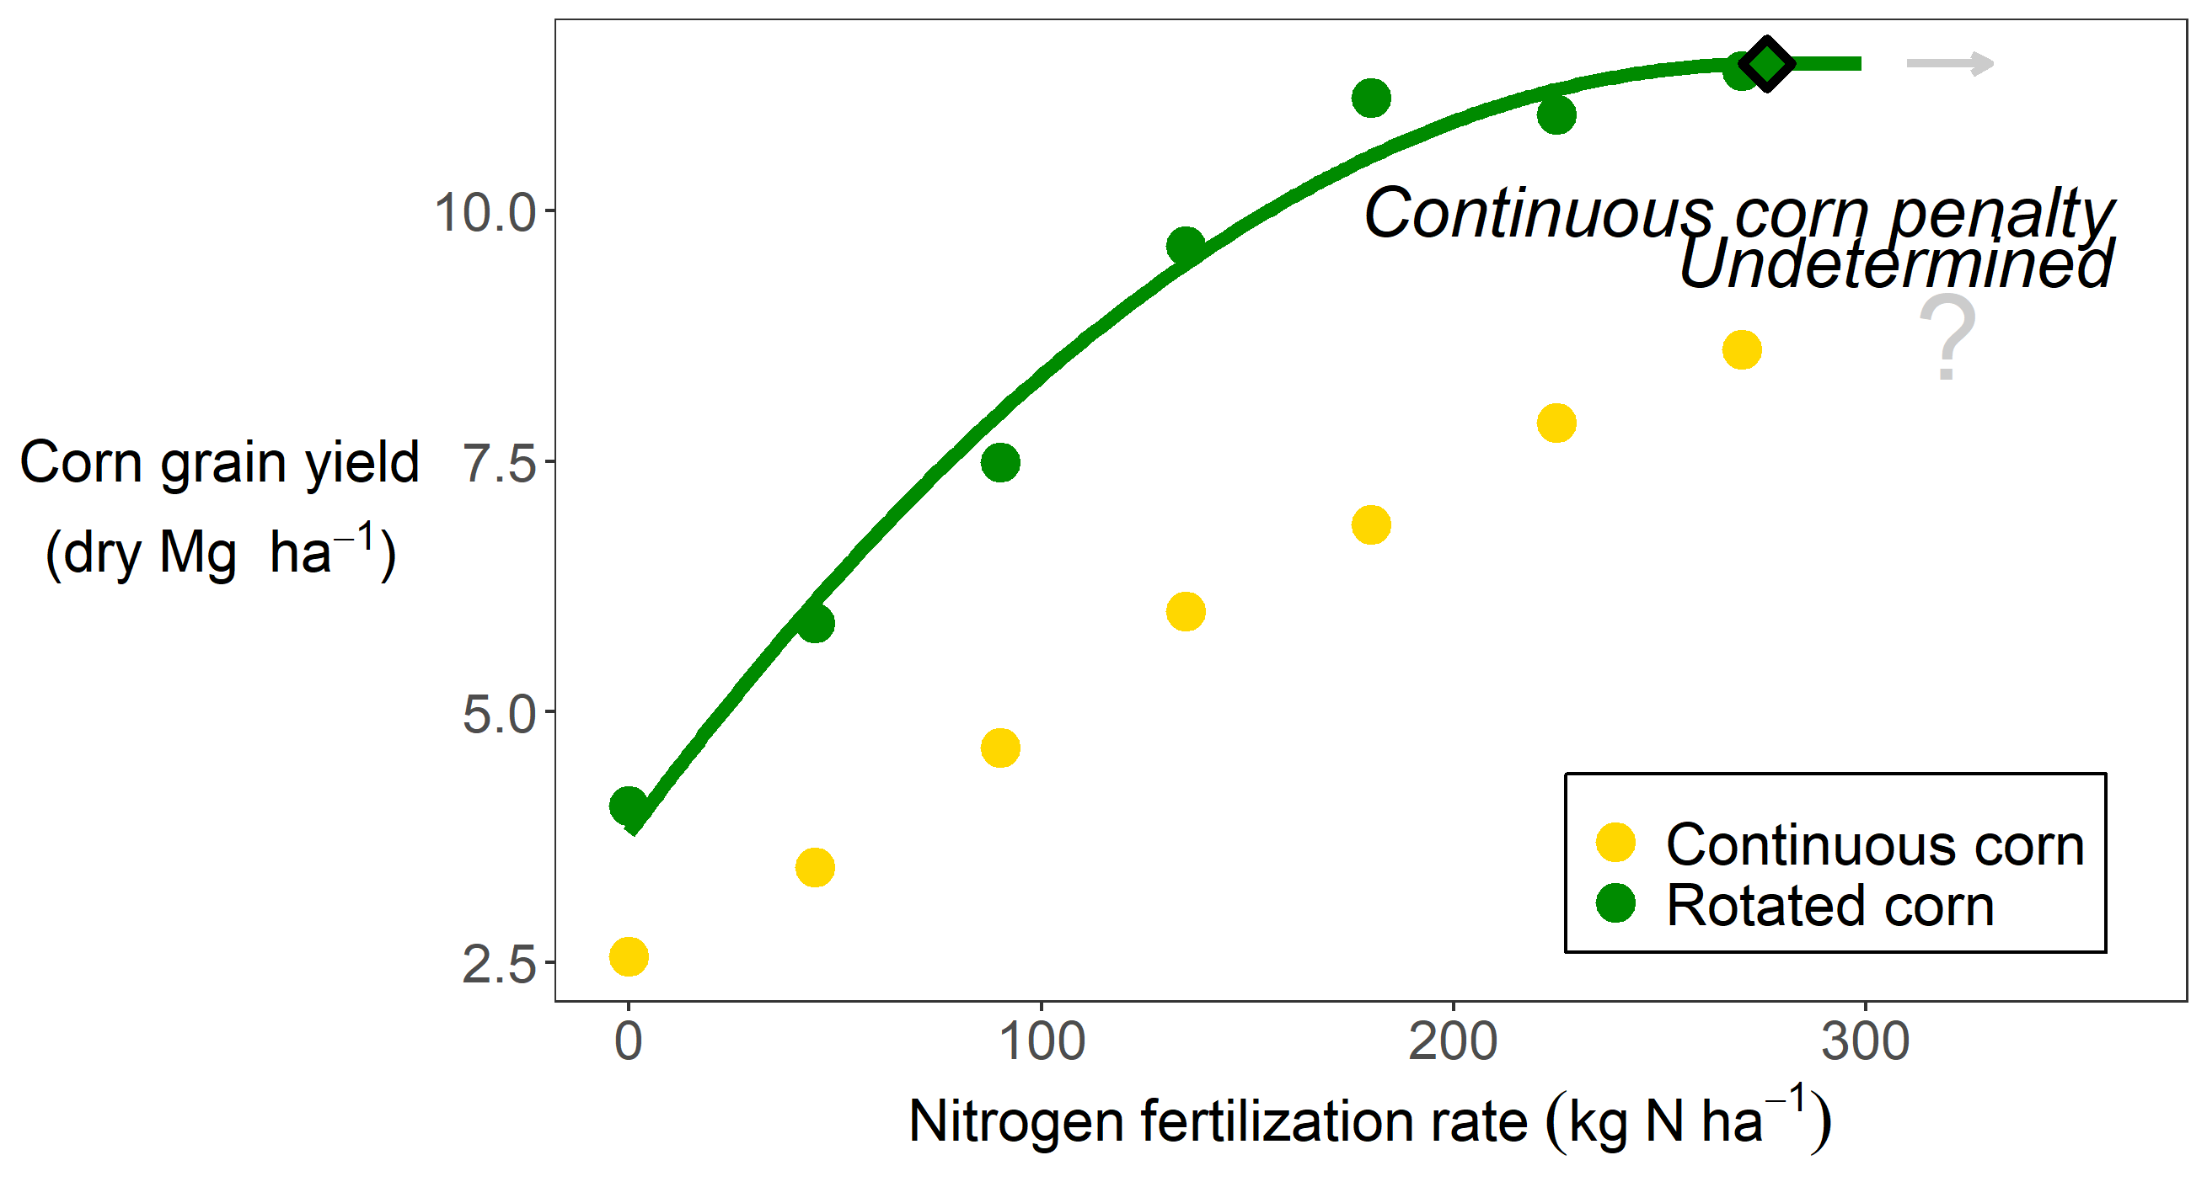
Example of undetermined penalty

Slide 89
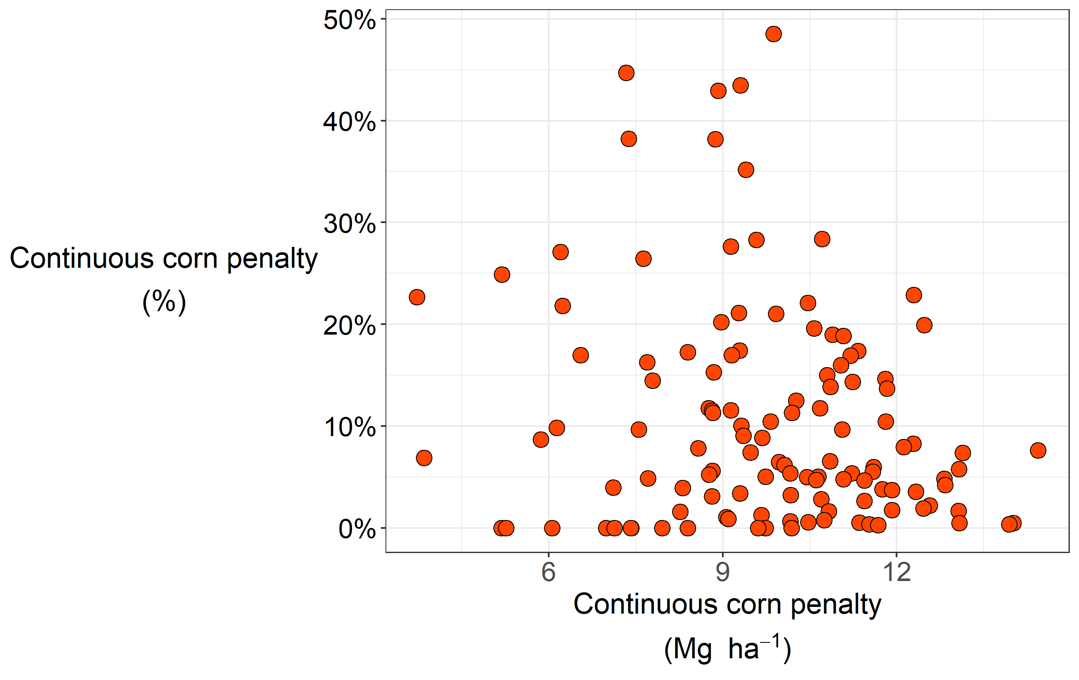
Penalty (%) not related to environmental yield potential
Rotated Corn Yield

Slide 90
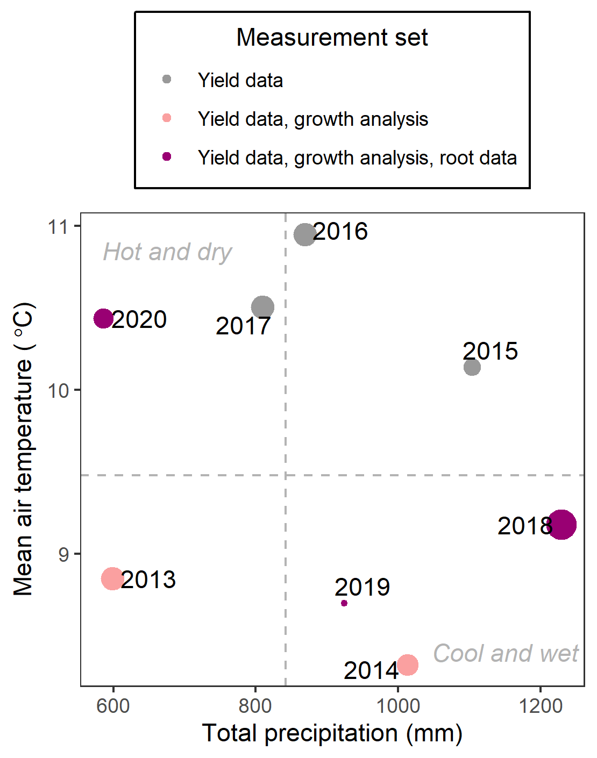

Slide 91
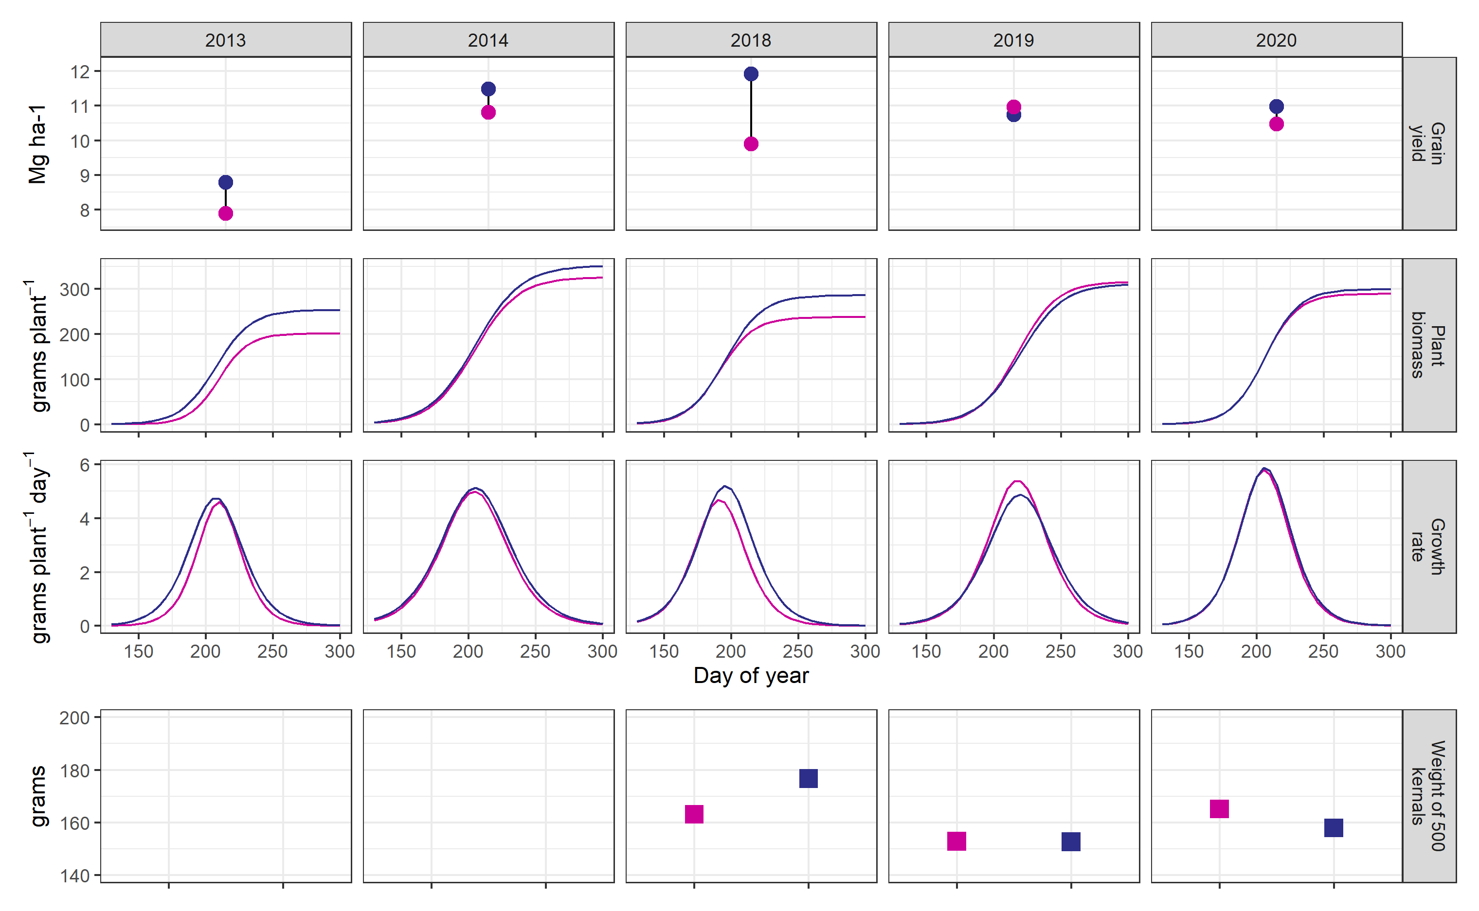
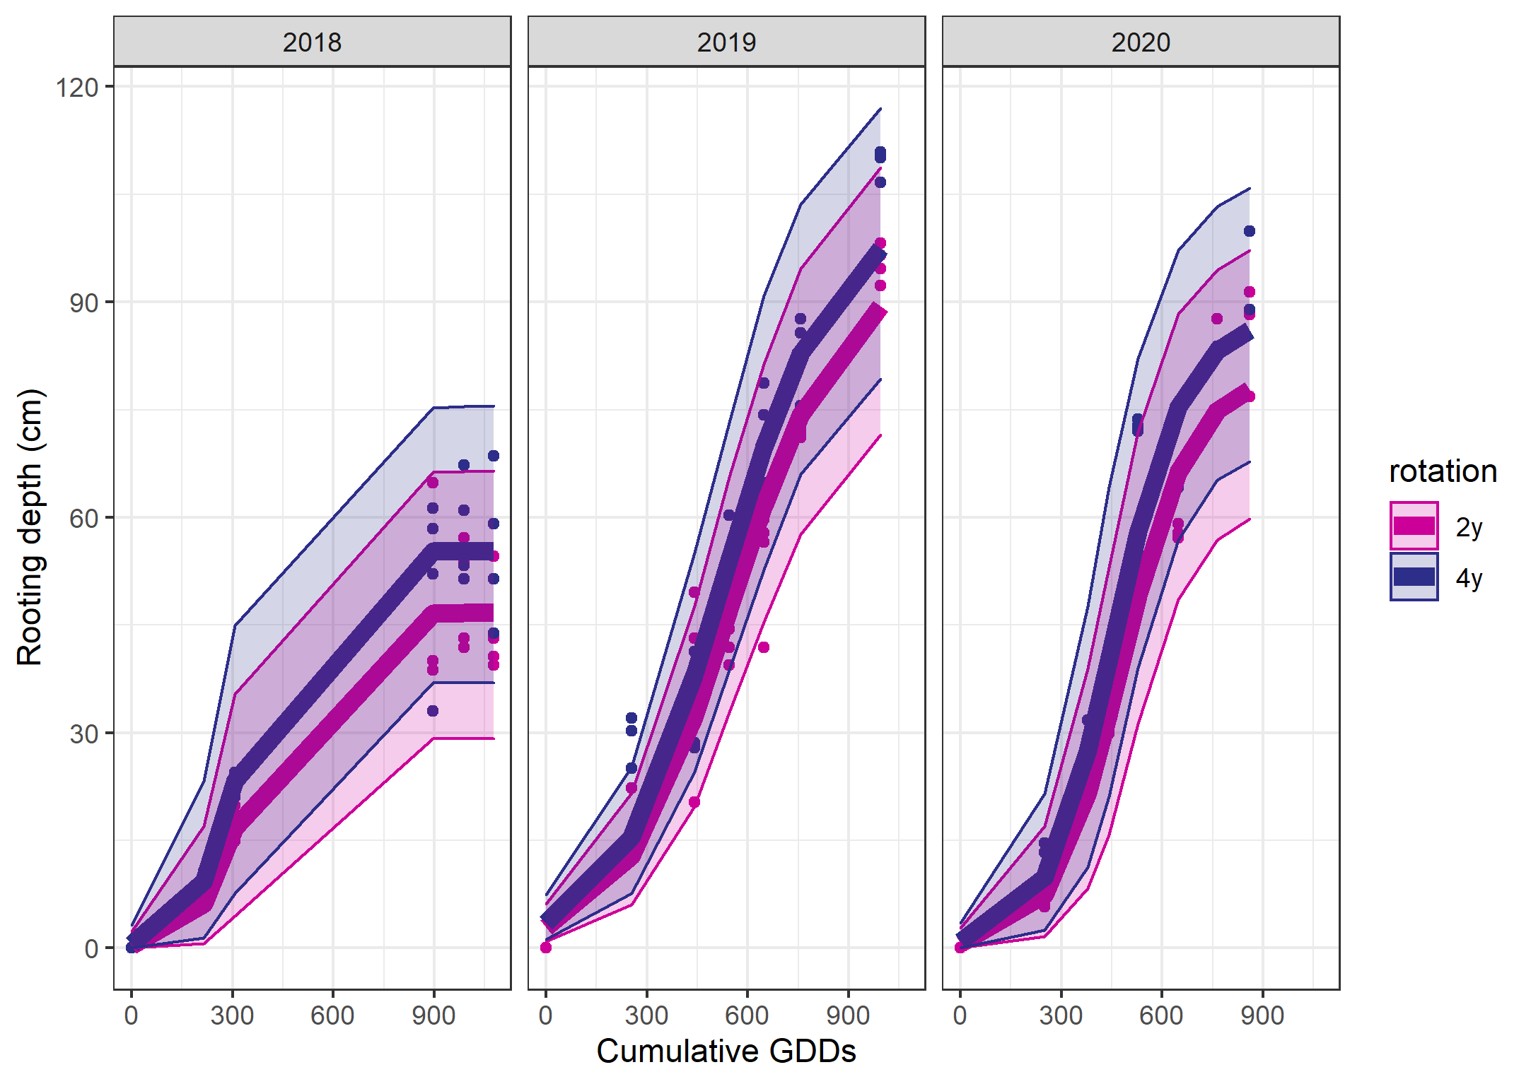


Slide 92


Slide 93


Slide 95


